Slide 1
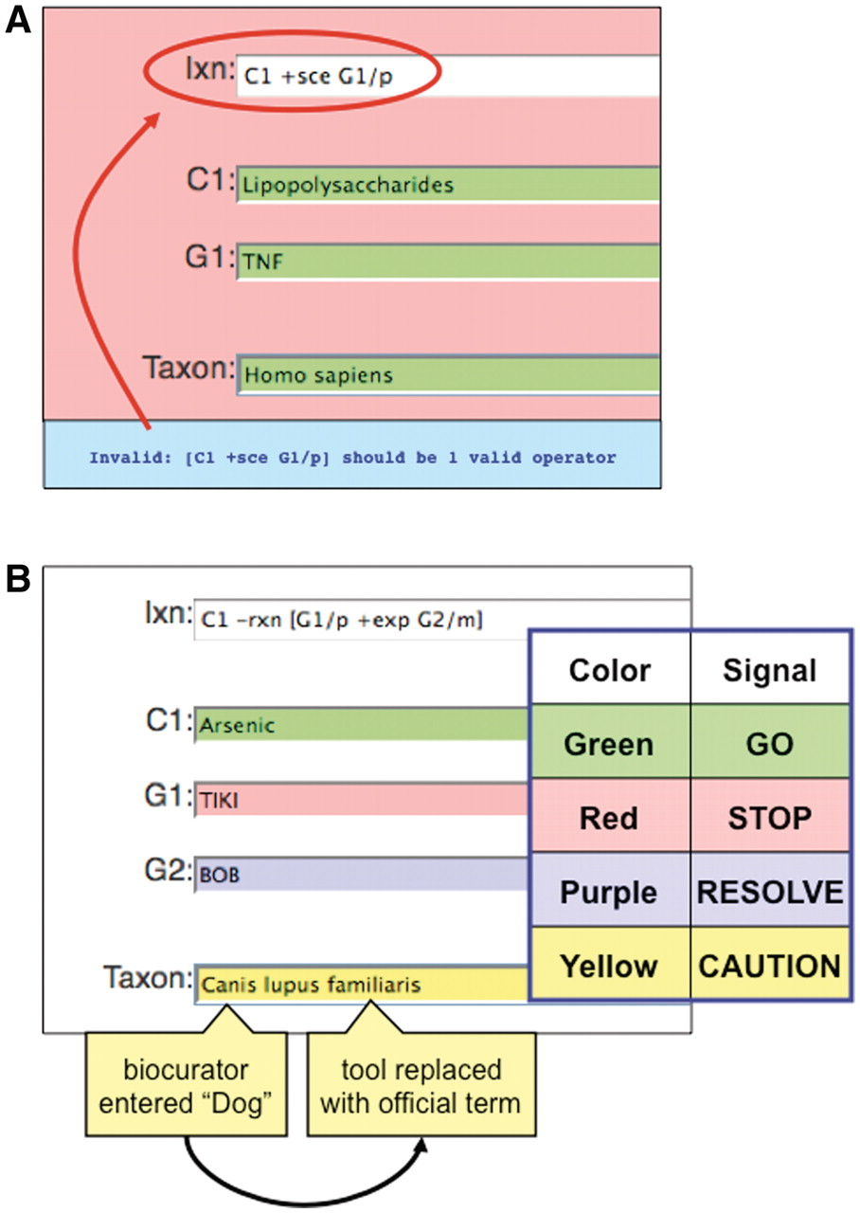
Figure 6. Color-coded QC. (A) If an invalid curation code (here, ‘sce’) is entered in the interaction field (Ixn), the ...
Notes:
Figure 6. Color-coded QC. (A) If an invalid curation code (here, ‘sce’) is entered in the interaction field (Ixn), the tool automatically alerts the biocurator by coloring the window red (‘STOP’) and producing an error report at the bottom of the page (red circle). The interaction cannot be saved until the biocurator fixes the error. Notice that the terms for C1, G1 and Taxon are correctly entered and the fields remain green. (B) Terms entered by a biocurator for chemicals (C1), genes (G1, G2), diseases (data not shown) and Taxon are automatically compared against CTD’s controlled vocabularies and are color-coded according to their correspondence. Here, the C1 term Arsenic is an acceptable official term and is highlighted in green. The G1 term TIKI, however, does not match any official gene symbol or synonym in CTD, so the curation tool alerts the biocurator in red. The G2 term BOB does not match any official gene symbol in CTD, but is a synonym for more than one gene; since the tool cannot deduce which was the intended official symbol, the term is flagged as purple for the biocurator to resolve. In Taxon, however, the biocurator originally entered ‘Dog’ and the curation tool was able to resolve it as a synonym to just one official term; the tool automatically replaces ‘Dog’ with that term (Canis lupus familiaris) but still cautions the biocurator to double-check the automatic selection made by the curation tool.
Unless provided in the caption above, the following copyright applies to the content of this slide: © The Author(s) 2011. Published by Oxford University Press.This is Open Access article distributed under the terms of the Creative Commons Attribution Non-Commercial License (http://creativecommons.org/licenses/by-nc/2.5), which permits unrestricted non-commercial use, distribution, and reproduction in any medium, provided the original work is properly cited.

