Slide 1
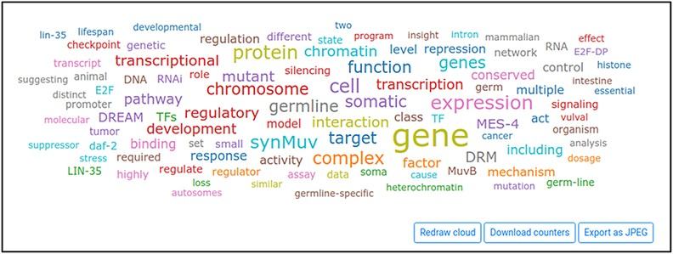
Figure 4. Word cloud displayed by Wormicloud for the query ‘DREAM complex’.
Notes:
Figure 4. Word cloud displayed by Wormicloud for the query ‘DREAM complex’.
Unless provided in the caption above, the following copyright applies to the content of this slide: Published by Oxford University Press 2021. This work is written by (a) US Government employee(s) and is in the public domain in the US.This work is written by (a) US Government employee(s) and is in the public domain in the US.

