Slide 1
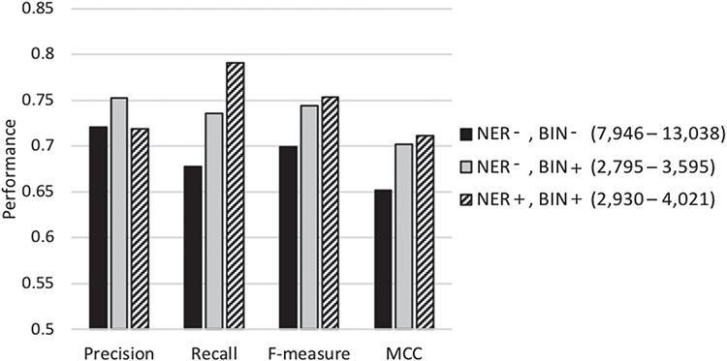
Figure 3 Performance of our classification scheme under different feature selection settings using 5-fold cross ...
Notes:
Figure 3 Performance of our classification scheme under different feature selection settings using 5-fold cross validation denotes the biochemical/genomic named entity recognition step and BIN represents the feature binning step. A ‘+’ sign represents employing the respective selection step, while a ‘−’ denotes its exclusion. The range of the number of features selected for the base-classifiers learning across the cross-validation runs is shown in parentheses.
Unless provided in the caption above, the following copyright applies to the content of this slide: © The Author(s) 2019. Published by Oxford University Press.This is an Open Access article distributed under the terms of the Creative Commons Attribution License (http://creativecommons.org/licenses/by/4.0/), which permits unrestricted reuse, distribution, and reproduction in any medium, provided the original work is properly cited.

