Slide 1
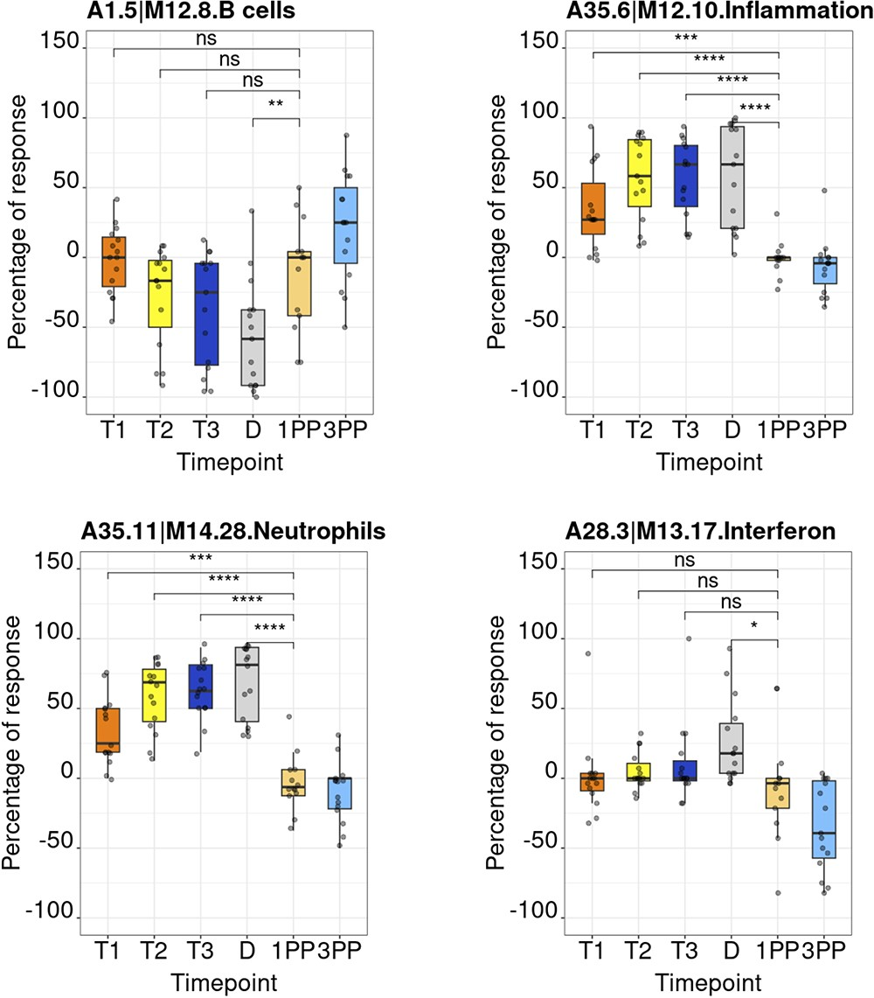
Figure 5. Module activity profiles. The boxplots represent activity profiles measured as ‘percentage of response’ ...
Notes:
Figure 5. Module activity profiles. The boxplots represent activity profiles measured as ‘percentage of response’ (proportion of constitutive transcripts for which abundance levels are significantly different compared to post-partum baseline). T1, T2 and T3 = first, second and third trimesters of pregnancy, respectively; D = delivery; 1 PP = 1 month post-partum; 3 PP = 3 months post-partum. Profiles are shown for 4 of the 382 modules that constitute the BloodGen3 repertoire.
Unless provided in the caption above, the following copyright applies to the content of this slide: © The Author(s) 2024. Published by Oxford University Press.This is an Open Access article distributed under the terms of the Creative Commons Attribution License (https://creativecommons.org/licenses/by/4.0/), which permits unrestricted reuse, distribution, and reproduction in any medium, provided the original work is properly cited.

