Slide 1
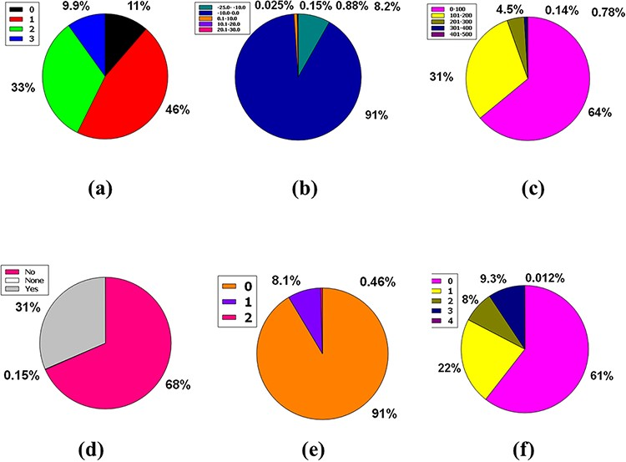
Figure 6. Venn diagram plot exhibition of the physicochemical properties of phytochemicals in ‘phytochemdb’ database: ...
Notes:
Figure 6. Venn diagram plot exhibition of the physicochemical properties of phytochemicals in ‘phytochemdb’ database: (a) proportions of compounds Leadlikeness; (b) LogKp percentages of compounds; (c) percentages of phytochemicals that satisfy diverse molar refractivity score; (d) P-gp substrate and P-gp non-substrate proportions of phytochemicals; (e) proportions of compounds that accomplish diverse standards of PAINS alert; (f) percentages of phytochemicals that satisfy diverse criteria of Lipinski rule of five.
Unless provided in the caption above, the following copyright applies to the content of this slide: © The Author(s) 2022. Published by Oxford University Press.This is an Open Access article distributed under the terms of the Creative Commons Attribution License (https://creativecommons.org/licenses/by/4.0/), which permits unrestricted reuse, distribution, and reproduction in any medium, provided the original work is properly cited.

