Slide 1
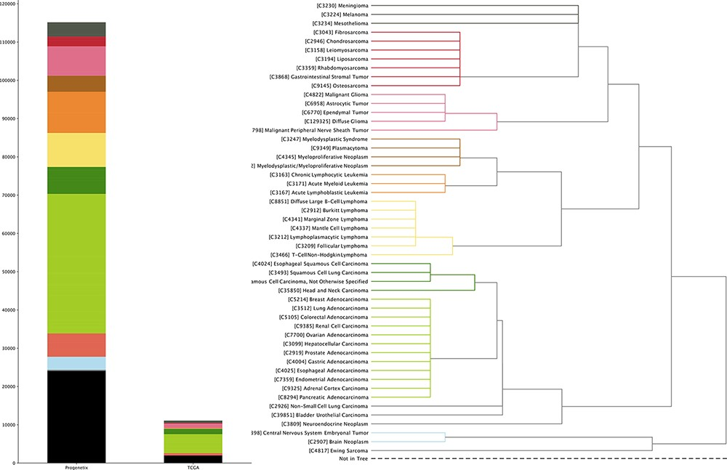
Figure 2. The genomic CNV fraction across 51 NCIt umbrella nodes Each dot represents one sample’s CNV fraction range ...
Notes:
Figure 2. The genomic CNV fraction across 51 NCIt umbrella nodes Each dot represents one sample’s CNV fraction range from 0 to 1 and the red horizontal line indicates median CNV of the respective cancer type. Each cancer type contains between 104 and 11 804 CNV profiles (median 904; See Supplementary Table S1).
Unless provided in the caption above, the following copyright applies to the content of this slide: © The Author(s) 2021. Published by Oxford University Press.This is an Open Access article distributed under the terms of the Creative Commons Attribution License (http://creativecommons.org/licenses/by/4.0/), which permits unrestricted reuse, distribution, and reproduction in any medium, provided the original work is properly cited.

