Slide 1
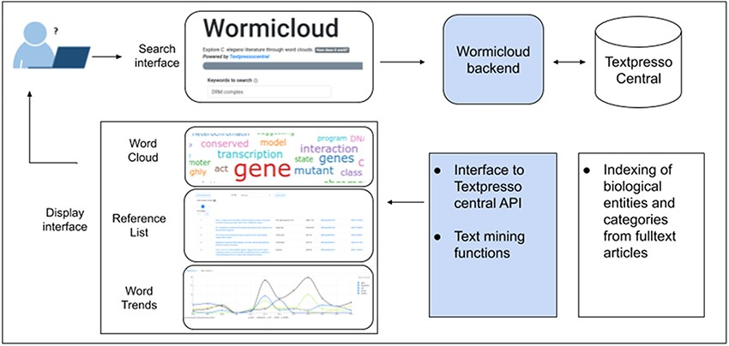
Figure 1. Wormicloud components and interactions with Textpresso Central through the Textpresso API.
Notes:
Figure 1. Wormicloud components and interactions with Textpresso Central through the Textpresso API.
Unless provided in the caption above, the following copyright applies to the content of this slide: Published by Oxford University Press 2021. This work is written by (a) US Government employee(s) and is in the public domain in the US.This work is written by (a) US Government employee(s) and is in the public domain in the US.

