Slide 1
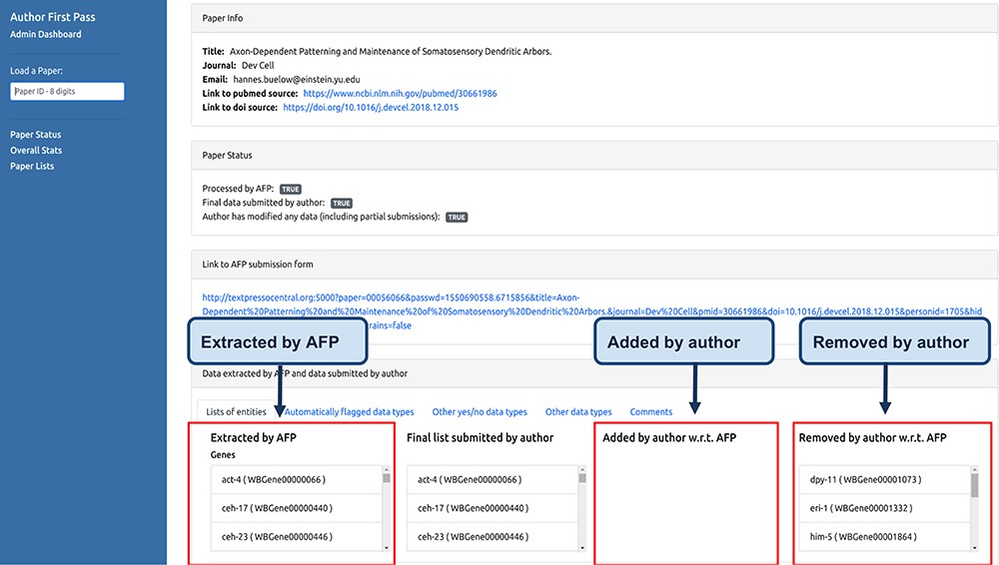
Figure 5 Curator dashboard. Curators at WB use this page to monitor the AFP system and to compare the data extracted ...
Notes:
Figure 5 Curator dashboard. Curators at WB use this page to monitor the AFP system and to compare the data extracted by the pipeline with those submitted by the authors.
Unless provided in the caption above, the following copyright applies to the content of this slide: © The Author(s) 2020. Published by Oxford University Press.This is an Open Access article distributed under the terms of the Creative Commons Attribution License (http://creativecommons.org/licenses/by/4.0/), which permits unrestricted reuse, distribution, and reproduction in any medium, provided the original work is properly cited.

