Slide 1
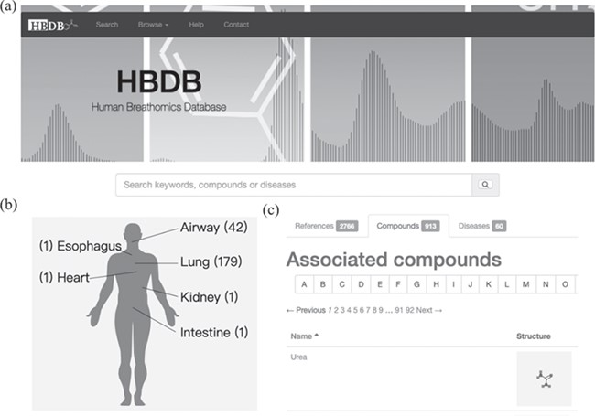
Figure 1 User interface and visualization of disease mapping. (a) Browse and search interface of the HBDB. (b) Disease ...
Notes:
Figure 1 User interface and visualization of disease mapping. (a) Browse and search interface of the HBDB. (b) Disease mapping to human physiology and statistics of references associated with diseases. (c) The collected compounds, references and diseases are listed in three tabs for browsing.
Unless provided in the caption above, the following copyright applies to the content of this slide: © The Author(s) 2020. Published by Oxford University Press.This is an Open Access article distributed under the terms of the Creative Commons Attribution License (http://creativecommons.org/licenses/by/4.0/), which permits unrestricted reuse, distribution, and reproduction in any medium, provided the original work is properly cited.

Slide 2
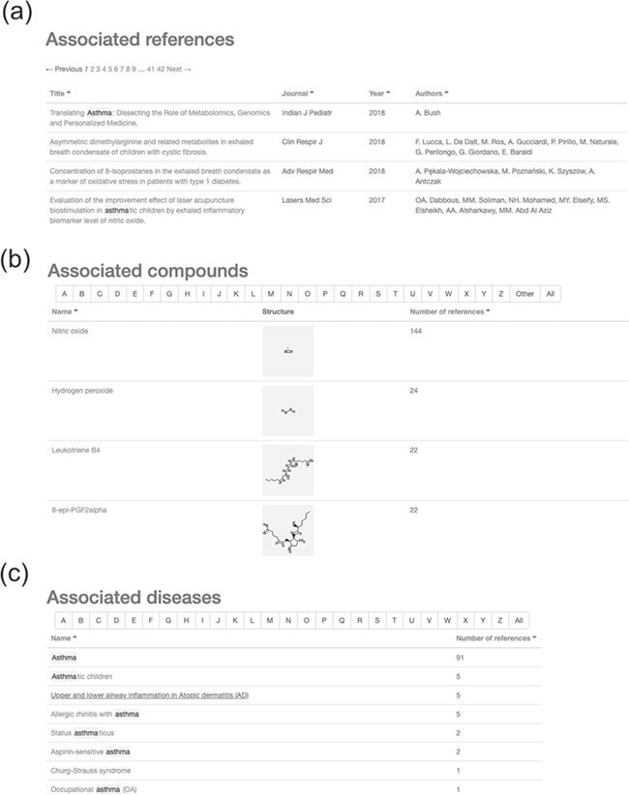
Figure 2 Results of searching for ‘asthma’ in the HBDB. (a) Associated references for asthma. (b) Associated compounds ...
Notes:
Figure 2 Results of searching for ‘asthma’ in the HBDB. (a) Associated references for asthma. (b) Associated compounds for asthma in descending order of related number of references. (c) Associated diseases for asthma.
Unless provided in the caption above, the following copyright applies to the content of this slide: © The Author(s) 2020. Published by Oxford University Press.This is an Open Access article distributed under the terms of the Creative Commons Attribution License (http://creativecommons.org/licenses/by/4.0/), which permits unrestricted reuse, distribution, and reproduction in any medium, provided the original work is properly cited.

Slide 3
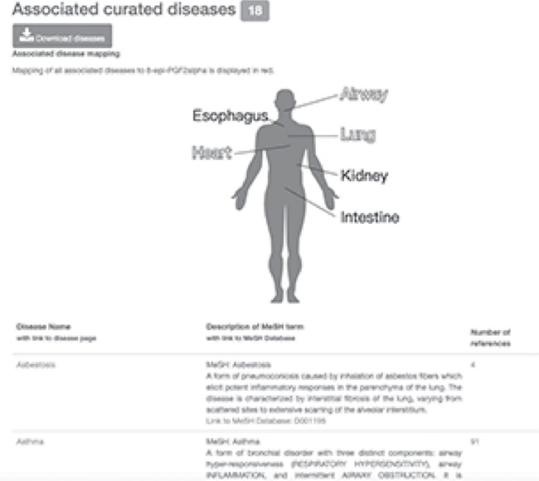
Figure 3 Information on 8-epi-PGF2α with associated curated diseases. Diseases associated with 8-epi-PGF2α are mapped ...
Notes:
Figure 3 Information on 8-epi-PGF2α with associated curated diseases. Diseases associated with 8-epi-PGF2α are mapped to a human physiological map in red and listed in a table with MeSH definition.
Unless provided in the caption above, the following copyright applies to the content of this slide: © The Author(s) 2020. Published by Oxford University Press.This is an Open Access article distributed under the terms of the Creative Commons Attribution License (http://creativecommons.org/licenses/by/4.0/), which permits unrestricted reuse, distribution, and reproduction in any medium, provided the original work is properly cited.

Slide 4
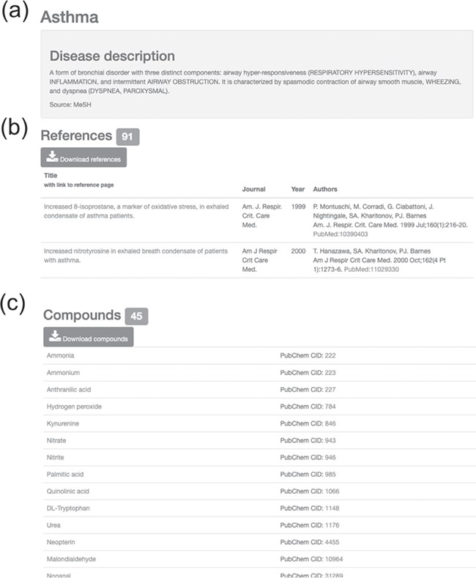
Figure 4 Information on asthma with associated references and compounds. (a) Disease description. (b) Downloadable ...
Notes:
Figure 4 Information on asthma with associated references and compounds. (a) Disease description. (b) Downloadable list of associated references for asthma. (c) Downloadable list of associated compounds for asthma.
Unless provided in the caption above, the following copyright applies to the content of this slide: © The Author(s) 2020. Published by Oxford University Press.This is an Open Access article distributed under the terms of the Creative Commons Attribution License (http://creativecommons.org/licenses/by/4.0/), which permits unrestricted reuse, distribution, and reproduction in any medium, provided the original work is properly cited.

Slide 5
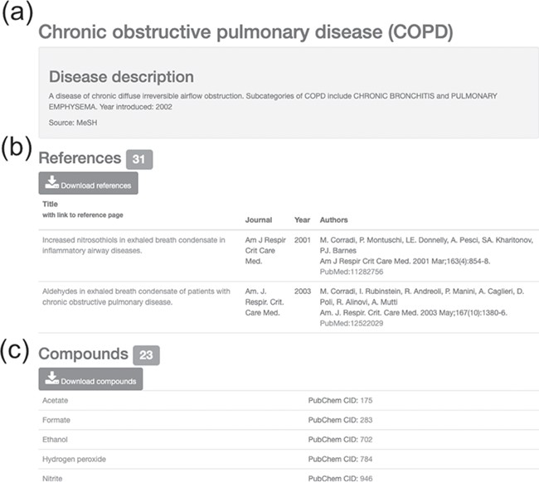
Figure 5 Information on COPD with associated references and compounds. (a) Disease description. (b) Downloadable list ...
Notes:
Figure 5 Information on COPD with associated references and compounds. (a) Disease description. (b) Downloadable list of associated references for COPD. (c) Downloadable list of associated compounds for COPD.
Unless provided in the caption above, the following copyright applies to the content of this slide: © The Author(s) 2020. Published by Oxford University Press.This is an Open Access article distributed under the terms of the Creative Commons Attribution License (http://creativecommons.org/licenses/by/4.0/), which permits unrestricted reuse, distribution, and reproduction in any medium, provided the original work is properly cited.

