Slide 1
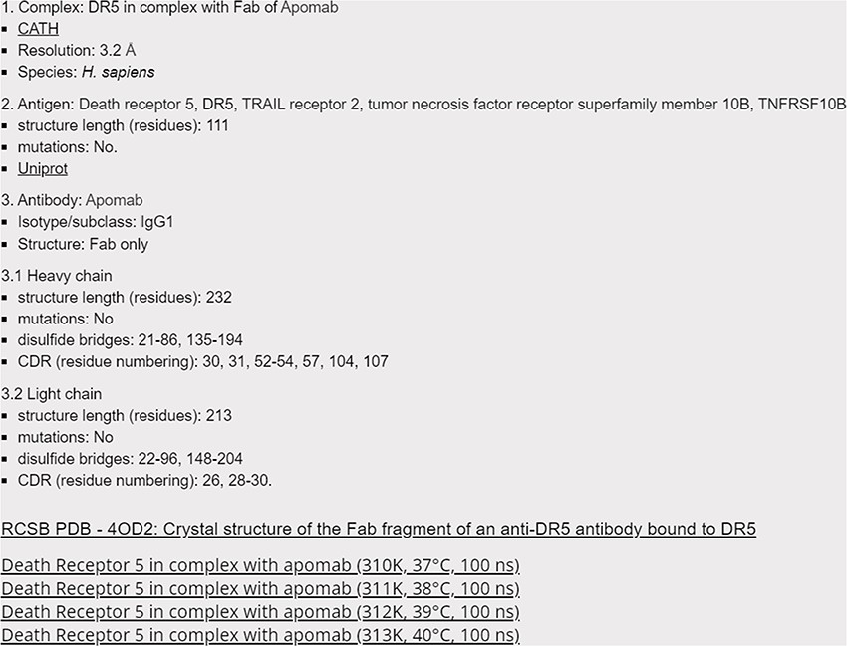
Figure 2. Screenshot of the 4OD2 entry (Death Receptor 5 in complex with apomab), with hyperlinks to CATH, Uniprot and ...
Notes:
Figure 2. Screenshot of the 4OD2 entry (Death Receptor 5 in complex with apomab), with hyperlinks to CATH, Uniprot and RCSB databases, as well as to Harvard Dataverse for accessing the raw data.
Unless provided in the caption above, the following copyright applies to the content of this slide: © The Author(s) 2024. Published by Oxford University Press.This is an Open Access article distributed under the terms of the Creative Commons Attribution License (https://creativecommons.org/licenses/by/4.0/), which permits unrestricted reuse, distribution, and reproduction in any medium, provided the original work is properly cited.

