Slide 1
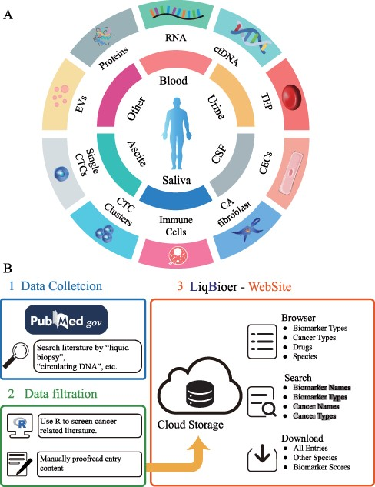
Figure 1. Construction of LiqBioer. (A) Biomarkers in body fluids, such as blood, urine, CSF, saliva and ascites. EVs, ...
Notes:
Figure 1. Construction of LiqBioer. (A) Biomarkers in body fluids, such as blood, urine, CSF, saliva and ascites. EVs, proteins, circulating cell-free RNA (non-coding and messenger RNA), ctDNA, TEPs, the tumor cell fraction with CTCs and the non-tumor cell fraction (immune cells, CECs or CA fibroblasts) can be detected in the different body fluids. CSF, cerebrospinal fluid; EV, extracellular vesicle; CA fibroblast, cancer-associated fibroblast; CEC, circulating endothelial cell; TEP, tumor-educated platelet. (B) Process of data collection, filtering and website structure. 1: Data collection. 2: Data filtration. 3: Structure of website.
Unless provided in the caption above, the following copyright applies to the content of this slide: © The Author(s) 2022. Published by Oxford University Press.This is an Open Access article distributed under the terms of the Creative Commons Attribution-NonCommercial License (https://creativecommons.org/licenses/by-nc/4.0/), which permits non-commercial re-use, distribution, and reproduction in any medium, provided the original work is properly cited. For commercial re-use, please contact journals.permissions@oup.com

Slide 2
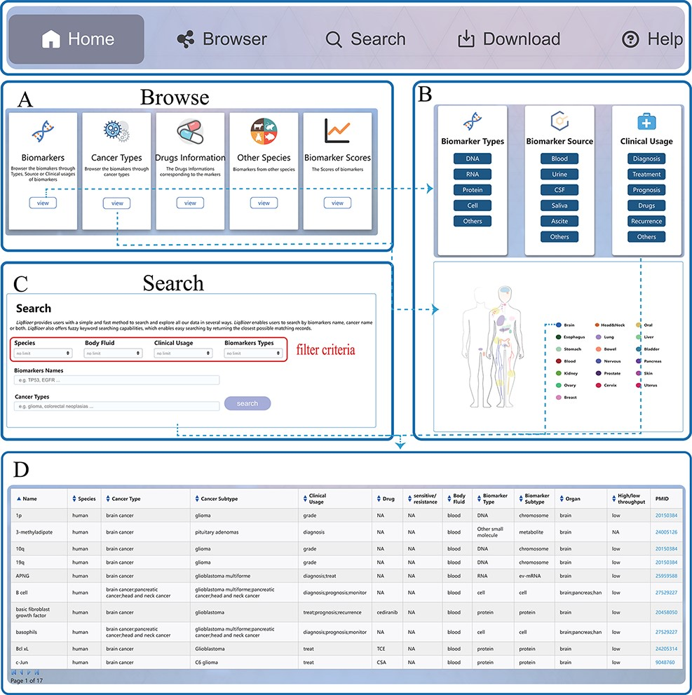
Figure 2. Usage instructions of LiqBioer. (A) Browse page. (B) Subpages of the browse page. (C) Search page. (D) Table ...
Notes:
Figure 2. Usage instructions of LiqBioer. (A) Browse page. (B) Subpages of the browse page. (C) Search page. (D) Table of search and browse results.
Unless provided in the caption above, the following copyright applies to the content of this slide: © The Author(s) 2022. Published by Oxford University Press.This is an Open Access article distributed under the terms of the Creative Commons Attribution-NonCommercial License (https://creativecommons.org/licenses/by-nc/4.0/), which permits non-commercial re-use, distribution, and reproduction in any medium, provided the original work is properly cited. For commercial re-use, please contact journals.permissions@oup.com

Slide 3
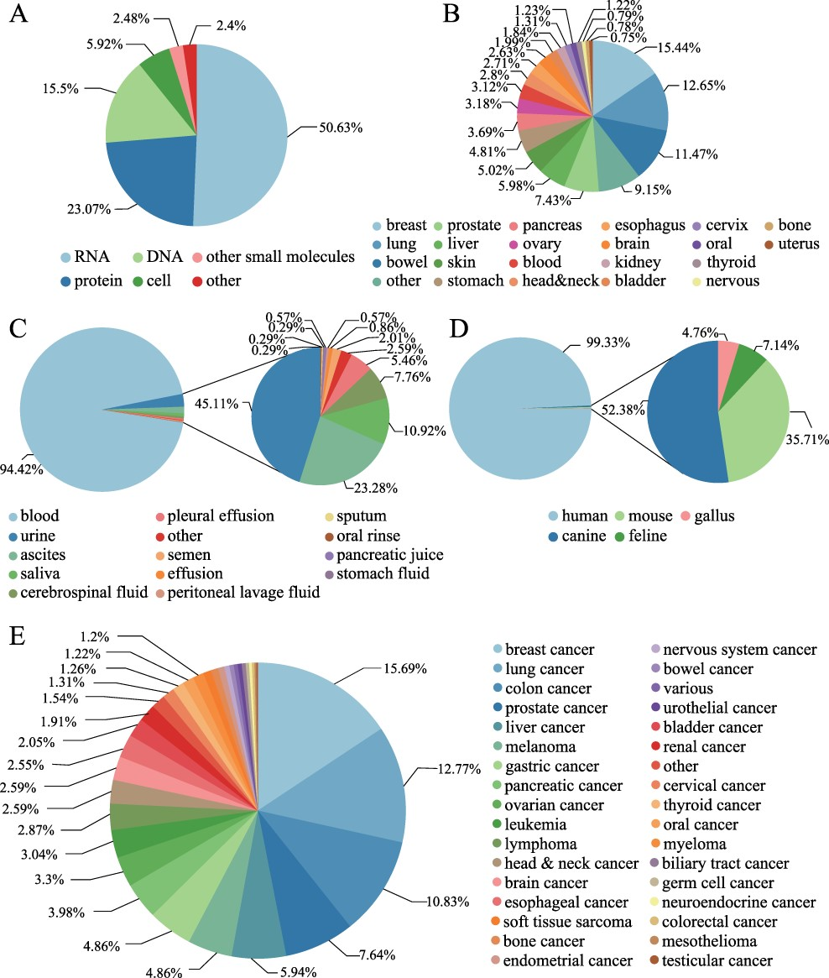
Figure 3. Statistics of biomarkers in LiqBioer. (A) Classification of biomarkers. (B) Tissues of cancer. (C) Source of ...
Notes:
Figure 3. Statistics of biomarkers in LiqBioer. (A) Classification of biomarkers. (B) Tissues of cancer. (C) Source of body fluid. (D) Source species for biomarkers. (E) Cancer types for biomarkers.
Unless provided in the caption above, the following copyright applies to the content of this slide: © The Author(s) 2022. Published by Oxford University Press.This is an Open Access article distributed under the terms of the Creative Commons Attribution-NonCommercial License (https://creativecommons.org/licenses/by-nc/4.0/), which permits non-commercial re-use, distribution, and reproduction in any medium, provided the original work is properly cited. For commercial re-use, please contact journals.permissions@oup.com

