Slide 1
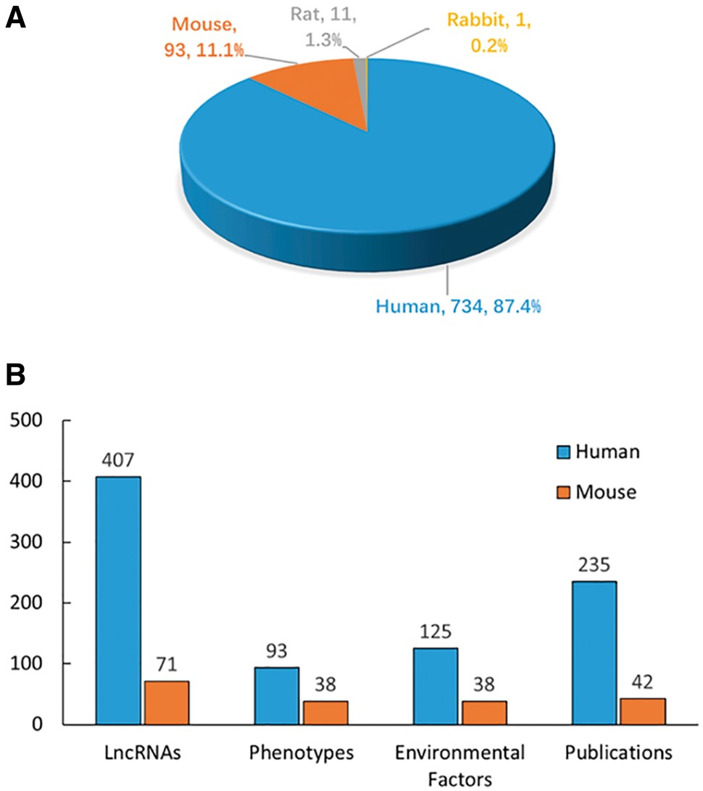
Figure 2. Statistics and distribution of data in DLREFD. (A) Entry distribution in different species. (B) Number of ...
Notes:
Figure 2. Statistics and distribution of data in DLREFD. (A) Entry distribution in different species. (B) Number of lncRNAs, phenotypes, EFs and publications for human and mouse.
Unless provided in the caption above, the following copyright applies to the content of this slide: © The Author(s) 2017. Published by Oxford University Press.This is an Open Access article distributed under the terms of the Creative Commons Attribution License (http://creativecommons.org/licenses/by/4.0/), which permits unrestricted reuse, distribution, and reproduction in any medium, provided the original work is properly cited.

