Slide 1
Figure 1 WikiText syntax for Semantic Wiki Link as compared with a normal link.
Notes:
Figure 1 WikiText syntax for Semantic Wiki Link as compared with a normal link.
Unless provided in the caption above, the following copyright applies to the content of this slide: © The Author(s) 2012. Published by Oxford University Press.This is an Open Access article distributed under the terms of the Creative Commons Attribution Non-Commercial License (http://creativecommons.org/licenses/by-nc/3.0), which permits unrestricted non-commercial use, distribution, and reproduction in any medium, provided the original work is properly cited.

Slide 2
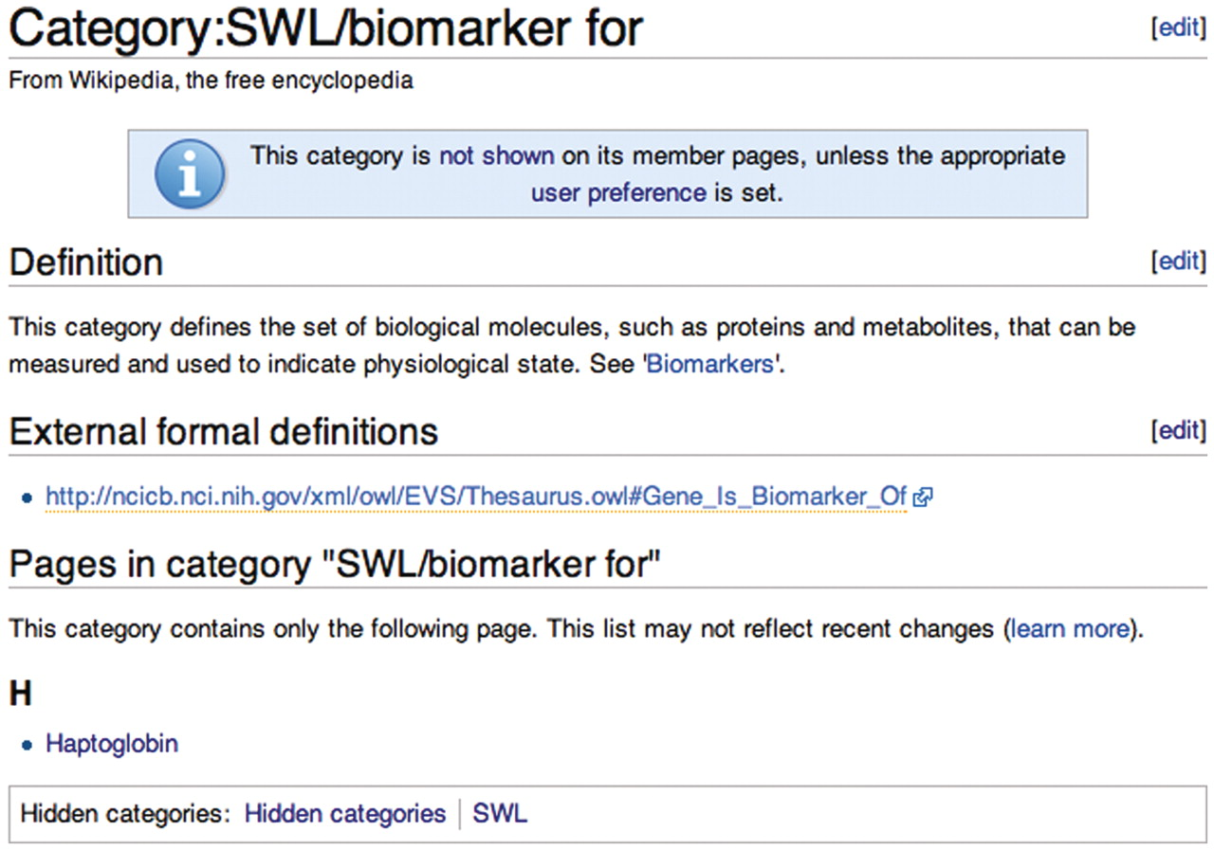
Figure 2 Wikipedia category page for the ‘biomarker for’ relationship type.
Notes:
Figure 2 Wikipedia category page for the ‘biomarker for’ relationship type.
Unless provided in the caption above, the following copyright applies to the content of this slide: © The Author(s) 2012. Published by Oxford University Press.This is an Open Access article distributed under the terms of the Creative Commons Attribution Non-Commercial License (http://creativecommons.org/licenses/by-nc/3.0), which permits unrestricted non-commercial use, distribution, and reproduction in any medium, provided the original work is properly cited.

Slide 3
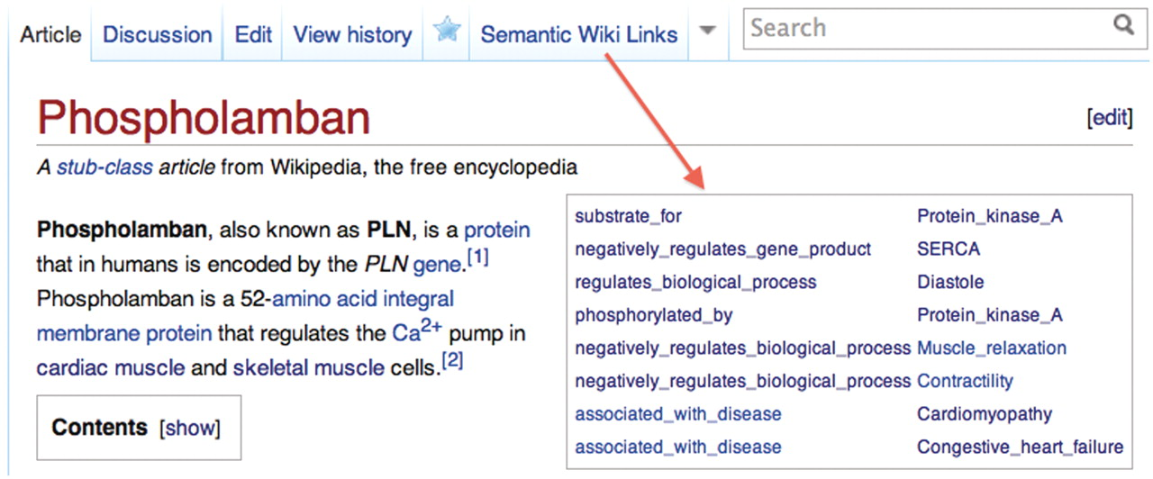
Figure 3 The infobox on the article for Phospholamban generated dynamically with the SWL_infobox user script.
Notes:
Figure 3 The infobox on the article for Phospholamban generated dynamically with the SWL_infobox user script.
Unless provided in the caption above, the following copyright applies to the content of this slide: © The Author(s) 2012. Published by Oxford University Press.This is an Open Access article distributed under the terms of the Creative Commons Attribution Non-Commercial License (http://creativecommons.org/licenses/by-nc/3.0), which permits unrestricted non-commercial use, distribution, and reproduction in any medium, provided the original work is properly cited.

Slide 4
Figure 4 Editing button for help inserting SWLs into Wikipedia articles.
Notes:
Figure 4 Editing button for help inserting SWLs into Wikipedia articles.
Unless provided in the caption above, the following copyright applies to the content of this slide: © The Author(s) 2012. Published by Oxford University Press.This is an Open Access article distributed under the terms of the Creative Commons Attribution Non-Commercial License (http://creativecommons.org/licenses/by-nc/3.0), which permits unrestricted non-commercial use, distribution, and reproduction in any medium, provided the original work is properly cited.

Slide 5
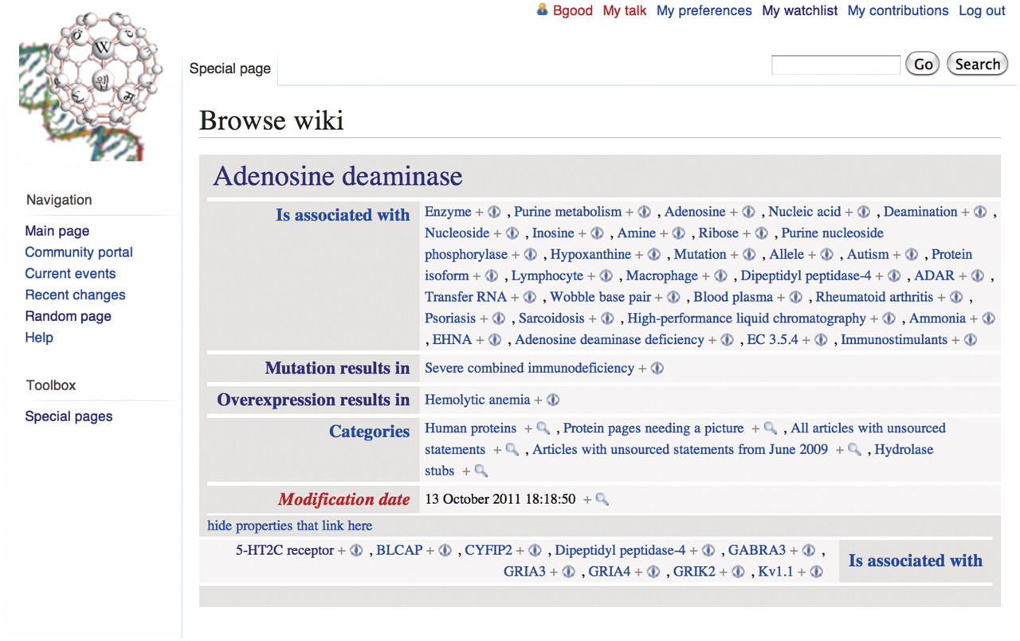
Figure 5 Semantic Media Wiki browse by properties feature accessible in Gene Wiki+. Displaying semantic content from ...
Notes:
Figure 5 Semantic Media Wiki browse by properties feature accessible in Gene Wiki+. Displaying semantic content from article about adenosine deaminase.
Unless provided in the caption above, the following copyright applies to the content of this slide: © The Author(s) 2012. Published by Oxford University Press.This is an Open Access article distributed under the terms of the Creative Commons Attribution Non-Commercial License (http://creativecommons.org/licenses/by-nc/3.0), which permits unrestricted non-commercial use, distribution, and reproduction in any medium, provided the original work is properly cited.

Slide 6
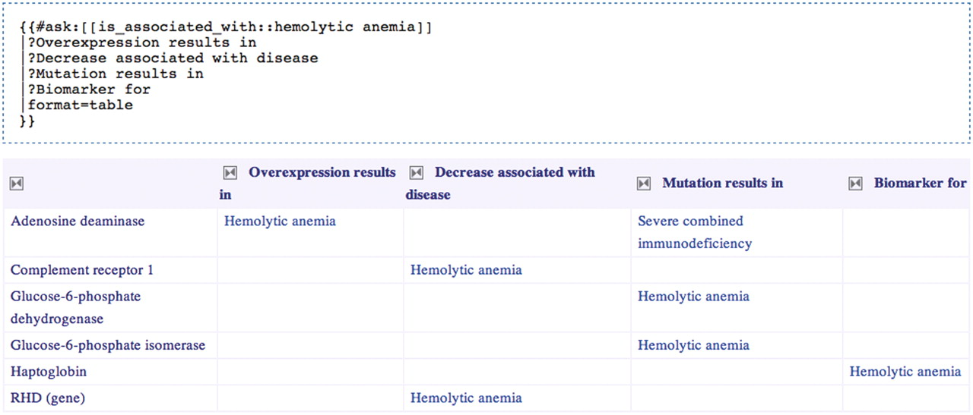
Figure 6 Selecting genes related to hemolytic anemia and exposing the nature of those relationships. The Semantic ...
Notes:
Figure 6 Selecting genes related to hemolytic anemia and exposing the nature of those relationships. The Semantic MediaWiki query is presented above the results table that it generates.
Unless provided in the caption above, the following copyright applies to the content of this slide: © The Author(s) 2012. Published by Oxford University Press.This is an Open Access article distributed under the terms of the Creative Commons Attribution Non-Commercial License (http://creativecommons.org/licenses/by-nc/3.0), which permits unrestricted non-commercial use, distribution, and reproduction in any medium, provided the original work is properly cited.

