Slide 1
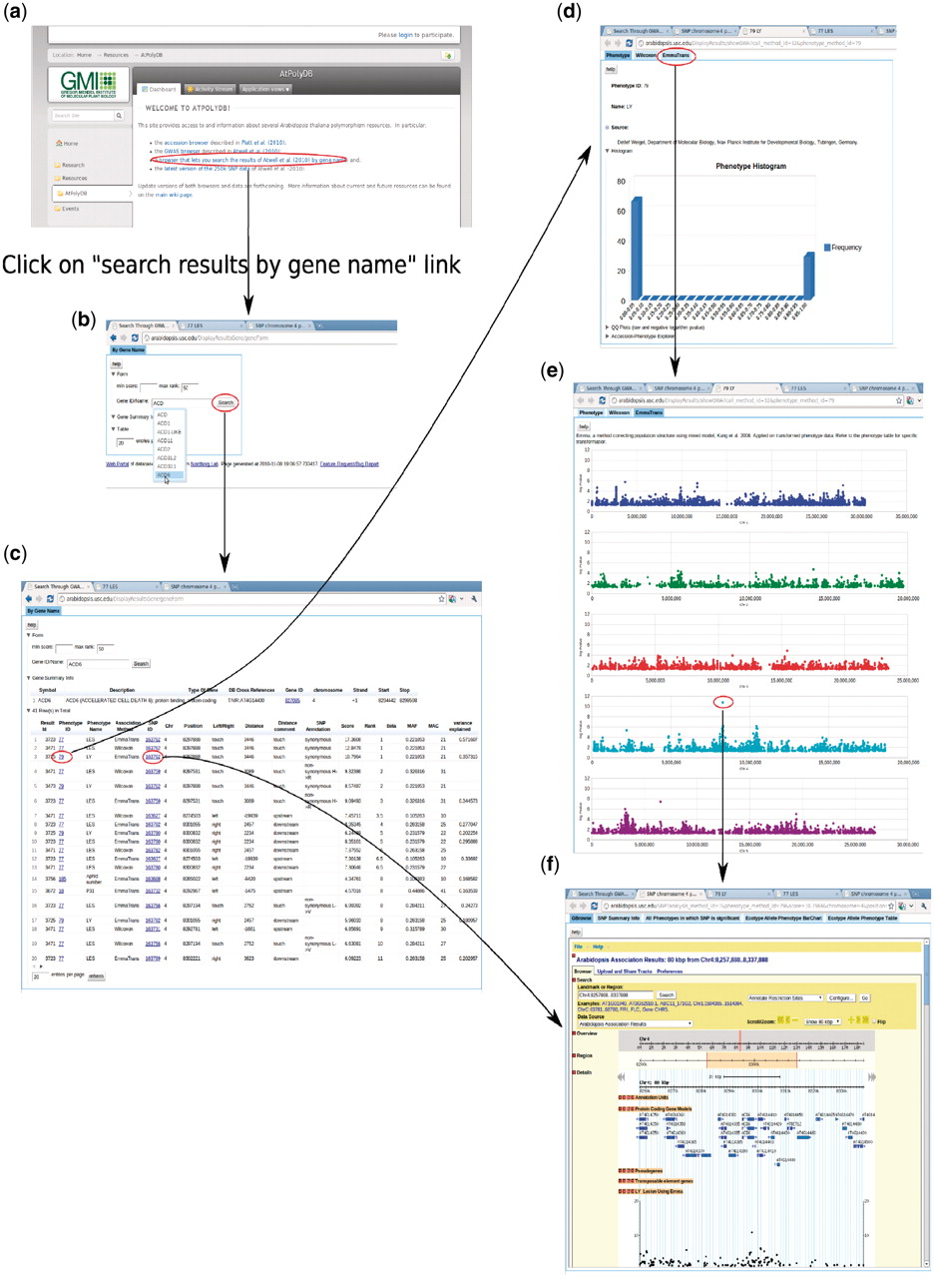
Figure 15. Backward genetics example. The gene of interest is ACD6. It starts from http://arabidopsis.usc.edu (a). Type ...
Notes:
Figure 15. Backward genetics example. The gene of interest is ACD6. It starts from http://arabidopsis.usc.edu (a). Type the gene name in the search-GWAS-by-gene-name interface (b). Auto-completion is supported in case the researcher remembers only part of the name. The interface returns one table containing information about the gene, another table which includes all the associations ranked top in certain phenotypes (c), determined by the ‘max rank’ threshold in the interface. Then user can click either the phenotype ID to go to the phenotype page (d), which leads to a genome-wide association plot (e) as in Figure 10 or the SNP ID to go to the SNP page (f) directly.
Unless provided in the caption above, the following copyright applies to the content of this slide: © The Author(s) 2011. Published by Oxford University Press.This is Open Access article distributed under the terms of the Creative Commons Attribution Non-Commercial License (http://creativecommons.org/licenses/by-nc/2.5), which permits unrestricted non-commercial use, distribution, and reproduction in any medium, provided the original work is properly cited.

