Slide 1
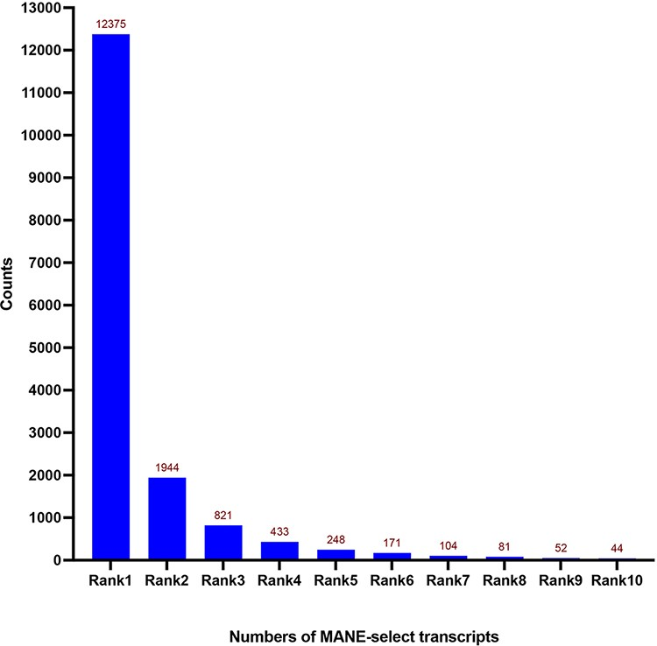
Figure 1. Distribution of expression Ranks (Rank 1–Rank 10) of MANE select transcripts. Most of the MANE select ...
Notes:
Figure 1. Distribution of expression Ranks (Rank 1–Rank 10) of MANE select transcripts. Most of the MANE select transcripts are the dominantly expressed ones—Rank 1 transcripts according to the GTEx expression dataset. Numbers of genes are shown on top of each column.
Unless provided in the caption above, the following copyright applies to the content of this slide: © The Author(s) 2022. Published by Oxford University Press.This is an Open Access article distributed under the terms of the Creative Commons Attribution-NonCommercial License (https://creativecommons.org/licenses/by-nc/4.0/), which permits non-commercial re-use, distribution, and reproduction in any medium, provided the original work is properly cited. For commercial re-use, please contact journals.permissions@oup.com

