Slide 1
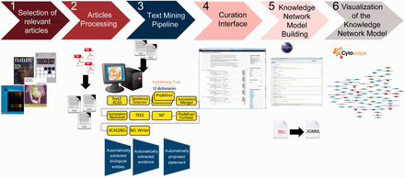
Figure 1. Overall workflow used to create the atherosclerosis plaque destabilization network. The knowledge extraction ...
Notes:
Figure 1. Overall workflow used to create the atherosclerosis plaque destabilization network. The knowledge extraction workflow contains six steps. Step 1: Selection of articles that represent specific biological context from which the knowledge base was constructed. Step 2: Text-processing with special character clearance and line break corrections to ensure proper machine parsing. Step 3: Text mining pipeline with an automated recognition of NER and relationships and coding into a BEL-compliant syntax. Step 4: Domain expert curation process in the curation interface based on the automatically created and proposed BEL statements. Step 5: Validation and transformation of BEL statements into knowledge network models. Step 6: Visualization of the knowledge network model.
Unless provided in the caption above, the following copyright applies to the content of this slide: © The Author(s) 2015. Published by Oxford University Press.This is an Open Access article distributed under the terms of the Creative Commons Attribution License (http://creativecommons.org/licenses/by/4.0/), which permits unrestricted reuse, distribution, and reproduction in any medium, provided the original work is properly cited.

Slide 2
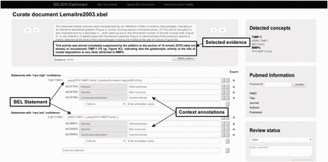
Figure 2. Screenshot of the knowledge extraction curation interface.
Notes:
Figure 2. Screenshot of the knowledge extraction curation interface.
Unless provided in the caption above, the following copyright applies to the content of this slide: © The Author(s) 2015. Published by Oxford University Press.This is an Open Access article distributed under the terms of the Creative Commons Attribution License (http://creativecommons.org/licenses/by/4.0/), which permits unrestricted reuse, distribution, and reproduction in any medium, provided the original work is properly cited.

Slide 3
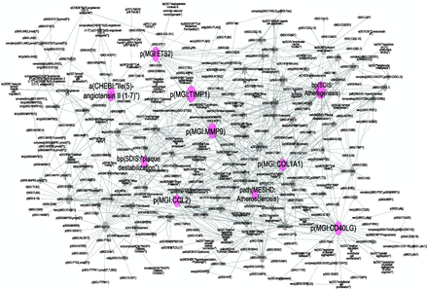
Figure 3. Atherosclerosis plaque destabilization network showing the degree of distribution of nodes. Biological ...
Notes:
Figure 3. Atherosclerosis plaque destabilization network showing the degree of distribution of nodes. Biological Entities or Nodes. Pink circles indicate the 10 most connected nodes (from 41° to 28°) defined as hubs. From left to right, the hub nodes are Ile2-angiotensin II ( 1-7 ), plaque destabilization, ETS2, CCL2, TIMP1, MMP9, atherosclerosis, COL1A1, atherogenesis and CD40LG. Relationships or edges. Gray lines with arrows indicate positive causal relationships; fine dotted lines with Ts indicate negative causal relationships; gray sine waves indicate correlative relationships; and fine dotted lines indicate non-causal relationship.
Unless provided in the caption above, the following copyright applies to the content of this slide: © The Author(s) 2015. Published by Oxford University Press.This is an Open Access article distributed under the terms of the Creative Commons Attribution License (http://creativecommons.org/licenses/by/4.0/), which permits unrestricted reuse, distribution, and reproduction in any medium, provided the original work is properly cited.

Slide 4
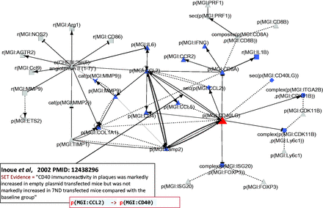
Figure 4. Part of the network showing CD40LG and its interactions with other hub nodes. Biological entities or nodes. ...
Notes:
Figure 4. Part of the network showing CD40LG and its interactions with other hub nodes. Biological entities or nodes. CD40LG is indicated in red, and the nodes that are regulated by CD40LG are indicated in blue. An example of evidence extracted from Inoue et al . ( 53 ) (PMID: 12438296) with the semi-automated extraction workflow and the associated BEL statement are given in the two boxes on the bottom left of the figure. Square, RNA abundance; triangle, protein abundance; V shape, protein activity; hexagon, complex; diamond, secretion. (B) Relationships or edges. Lines with dark arrows indicate positive causal relationships; lines with dark Ts indicate negative causal relationships; black sine waves indicate correlative relationships and black dotted lines indicate non-causal relationships.
Unless provided in the caption above, the following copyright applies to the content of this slide: © The Author(s) 2015. Published by Oxford University Press.This is an Open Access article distributed under the terms of the Creative Commons Attribution License (http://creativecommons.org/licenses/by/4.0/), which permits unrestricted reuse, distribution, and reproduction in any medium, provided the original work is properly cited.

