Slide 1
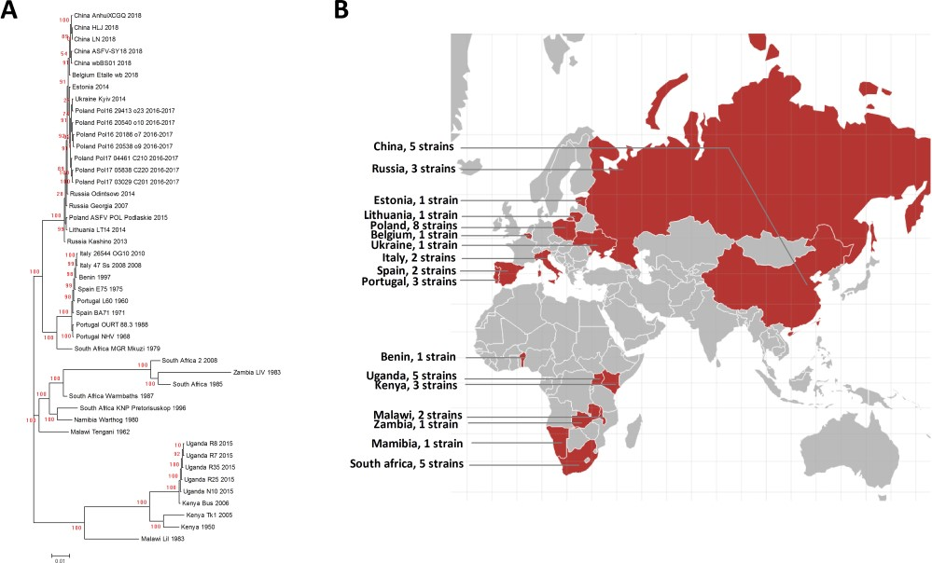
Figure 3 A. Phylogenetic tree of the ASFV strains in ASFVdb. The numbers marked in red are the marginal likelihoods of ...
Notes:
Figure 3 A. Phylogenetic tree of the ASFV strains in ASFVdb. The numbers marked in red are the marginal likelihoods of the tree. B. The distribution of strains in ASFVdb according to country.
Unless provided in the caption above, the following copyright applies to the content of this slide: © The Author(s) 2020. Published by Oxford University Press.This is an Open Access article distributed under the terms of the Creative Commons Attribution License (http://creativecommons.org/licenses/by/4.0/), which permits unrestricted reuse, distribution, and reproduction in any medium, provided the original work is properly cited.

