Slide 1
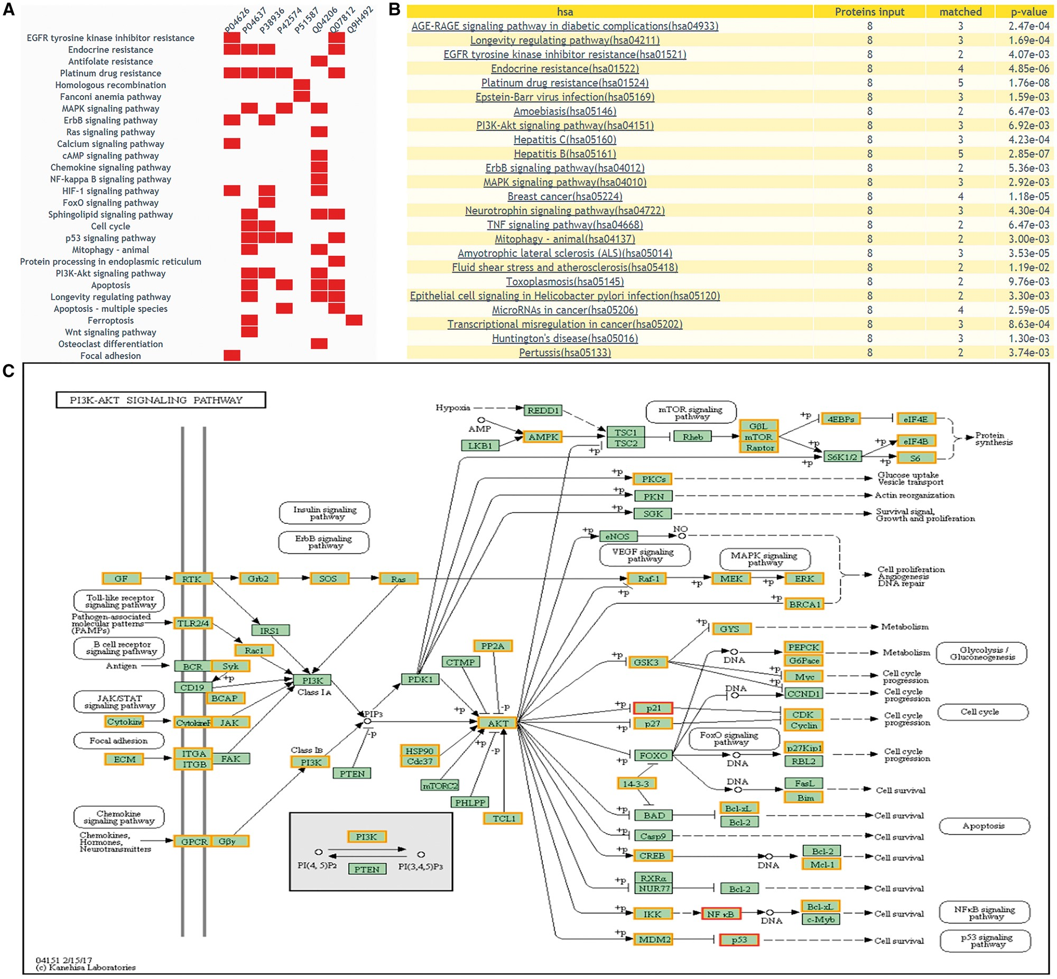
Figure 6. The returning page of enrichment analysis. (A) A heatmap is drawn showing the distribution of queried ...
Notes:
Figure 6. The returning page of enrichment analysis. (A) A heatmap is drawn showing the distribution of queried proteins in pathways. (B) The table lists those enriched pathways with a threshold of P-value <= 0.05. (C) DEPs on KEGG pathway maps. Blue means query proteins. Orange means the DEPs in our database and red means both DEPs and query proteins.
Unless provided in the caption above, the following copyright applies to the content of this slide: © The Author(s) 2018. Published by Oxford University Press.This is an Open Access article distributed under the terms of the Creative Commons Attribution License (http://creativecommons.org/licenses/by/4.0/), which permits unrestricted reuse, distribution, and reproduction in any medium, provided the original work is properly cited.

