Slide 1
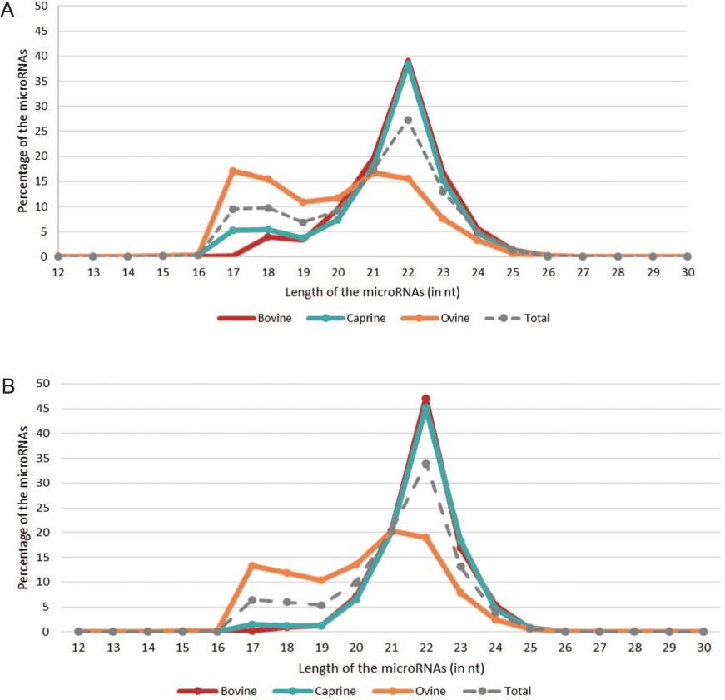
Figure 4 microRNA length distributions across species. The red, blue and orange lines correspond to the percentages of ...
Notes:
Figure 4 microRNA length distributions across species. The red, blue and orange lines correspond to the percentages of bovine, caprine and ovine microRNAs, respectively, based on their length [in nucleotides (nt)]. The gray dotted line represents all the microRNAs listed in RumimiR. (A) Percentage of all sequences collected in RumimiR. (B) Percentage of sequences with a low false-positive score (code containing 0 and 1 `1’).
Unless provided in the caption above, the following copyright applies to the content of this slide: © The Author(s) 2019. Published by Oxford University Press.This is an Open Access article distributed under the terms of the Creative Commons Attribution License (http://creativecommons.org/licenses/by/4.0/), which permits unrestricted reuse, distribution, and reproduction in any medium, provided the original work is properly cited.

