Slide 1
Figure 1 Overview of the AFP system.
Notes:
Figure 1 Overview of the AFP system.
Unless provided in the caption above, the following copyright applies to the content of this slide: © The Author(s) 2020. Published by Oxford University Press.This is an Open Access article distributed under the terms of the Creative Commons Attribution License (http://creativecommons.org/licenses/by/4.0/), which permits unrestricted reuse, distribution, and reproduction in any medium, provided the original work is properly cited.

Slide 2
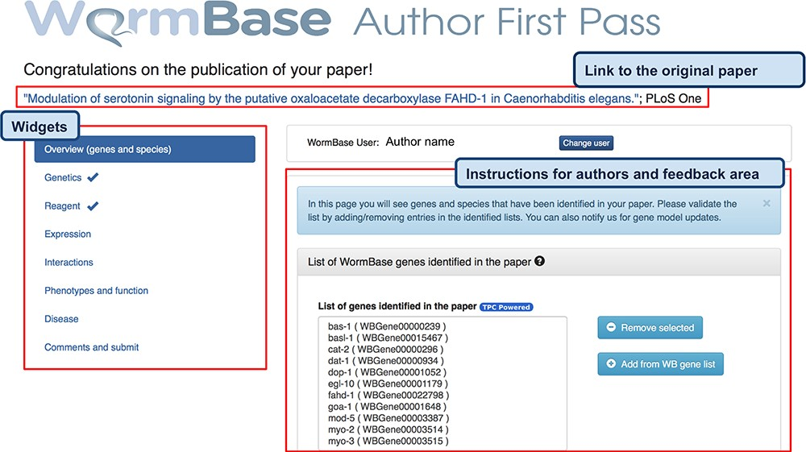
Figure 2 AFP feedback form for authors - Overview (genes and species) widget. The form is divided into widgets that ...
Notes:
Figure 2 AFP feedback form for authors - Overview (genes and species) widget. The form is divided into widgets that group the data types into different categories to simplify the work for authors—left sidebar. Between the title and the main author feedback area, there is a component that displays the WormBase person name and ID for the identified corresponding author and allows the users to select a different person using an autocomplete on WormBase database. The selected person ID is stored with the curated data in our database when the submission process is completed. Each widget shows a colored panel at the top with specific instructions on how to curate the included data types. An example of the list of genes extracted can be seen in the feedback area at the center of the page.
Unless provided in the caption above, the following copyright applies to the content of this slide: © The Author(s) 2020. Published by Oxford University Press.This is an Open Access article distributed under the terms of the Creative Commons Attribution License (http://creativecommons.org/licenses/by/4.0/), which permits unrestricted reuse, distribution, and reproduction in any medium, provided the original work is properly cited.

Slide 3
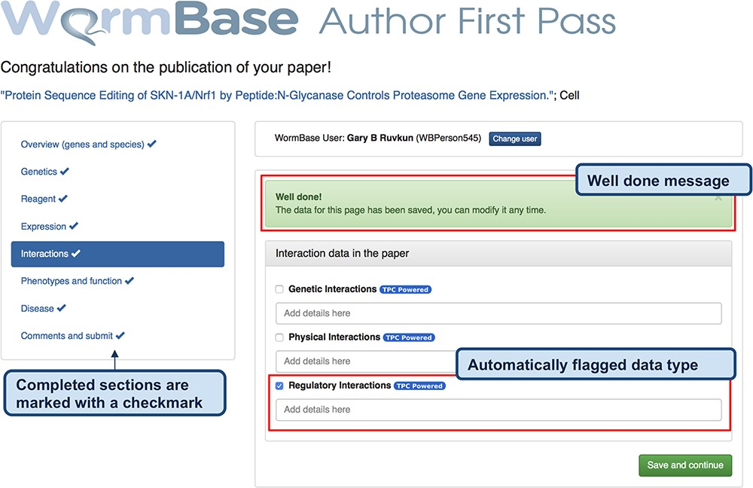
Figure 3 Feedback form for authors - completed form. When the author clicks ‘Save and continue’ (or ‘Finish and ...
Notes:
Figure 3 Feedback form for authors - completed form. When the author clicks ‘Save and continue’ (or ‘Finish and submit’ on the last widget), a pop-up message notifies that the data have been received by WB and the instruction alert turns green. The form returns a ‘Well done!’ message upon the completion of each section and the data are immediately stored in the WB database. In addition, to track the progress throughout the author curation process, completed sections are marked on the left menu with a special icon. The authors can modify the submitted data any time by returning to the form. The figure also shows an example of automatically classified data types, in this case regulatory interactions.
Unless provided in the caption above, the following copyright applies to the content of this slide: © The Author(s) 2020. Published by Oxford University Press.This is an Open Access article distributed under the terms of the Creative Commons Attribution License (http://creativecommons.org/licenses/by/4.0/), which permits unrestricted reuse, distribution, and reproduction in any medium, provided the original work is properly cited.

Slide 4
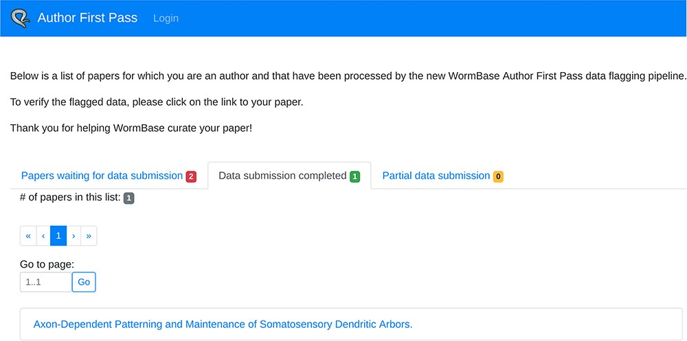
Figure 4 ‘My AFP papers’ page. The authors can retrieve links to the AFP feedback form for their papers through the ...
Notes:
Figure 4 ‘My AFP papers’ page. The authors can retrieve links to the AFP feedback form for their papers through the interface presented in this page.
Unless provided in the caption above, the following copyright applies to the content of this slide: © The Author(s) 2020. Published by Oxford University Press.This is an Open Access article distributed under the terms of the Creative Commons Attribution License (http://creativecommons.org/licenses/by/4.0/), which permits unrestricted reuse, distribution, and reproduction in any medium, provided the original work is properly cited.

Slide 5
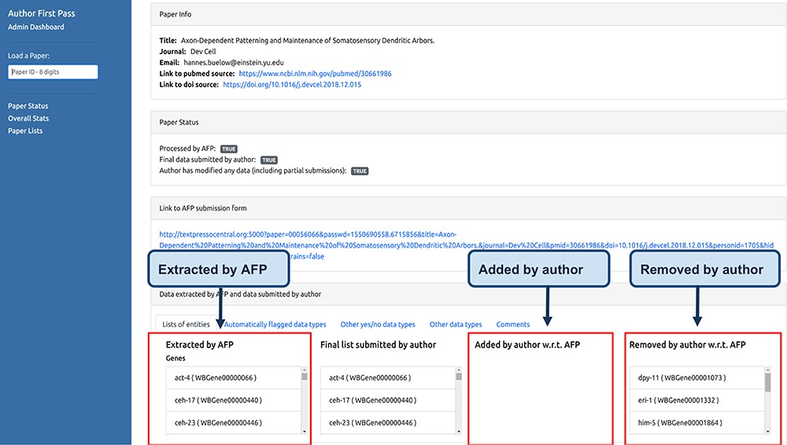
Figure 5 Curator dashboard. Curators at WB use this page to monitor the AFP system and to compare the data extracted ...
Notes:
Figure 5 Curator dashboard. Curators at WB use this page to monitor the AFP system and to compare the data extracted by the pipeline with those submitted by the authors.
Unless provided in the caption above, the following copyright applies to the content of this slide: © The Author(s) 2020. Published by Oxford University Press.This is an Open Access article distributed under the terms of the Creative Commons Attribution License (http://creativecommons.org/licenses/by/4.0/), which permits unrestricted reuse, distribution, and reproduction in any medium, provided the original work is properly cited.

Slide 6
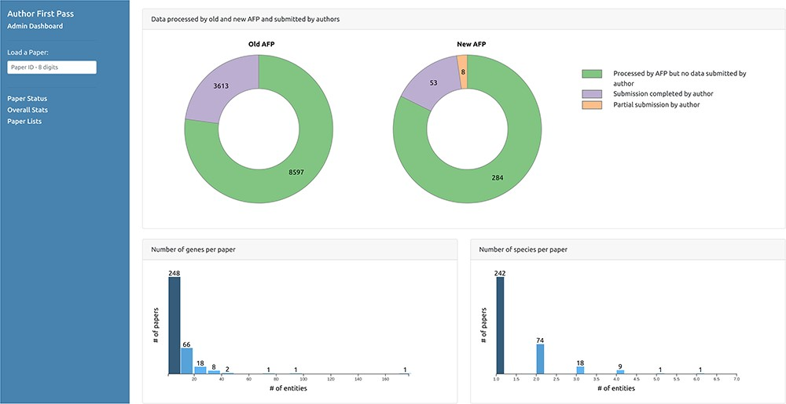
Figure 6 Curator dashboard - Statistics page. Curators can collect statistics on the extracted and submitted data ...
Notes:
Figure 6 Curator dashboard - Statistics page. Curators can collect statistics on the extracted and submitted data through this page.
Unless provided in the caption above, the following copyright applies to the content of this slide: © The Author(s) 2020. Published by Oxford University Press.This is an Open Access article distributed under the terms of the Creative Commons Attribution License (http://creativecommons.org/licenses/by/4.0/), which permits unrestricted reuse, distribution, and reproduction in any medium, provided the original work is properly cited.

Slide 7
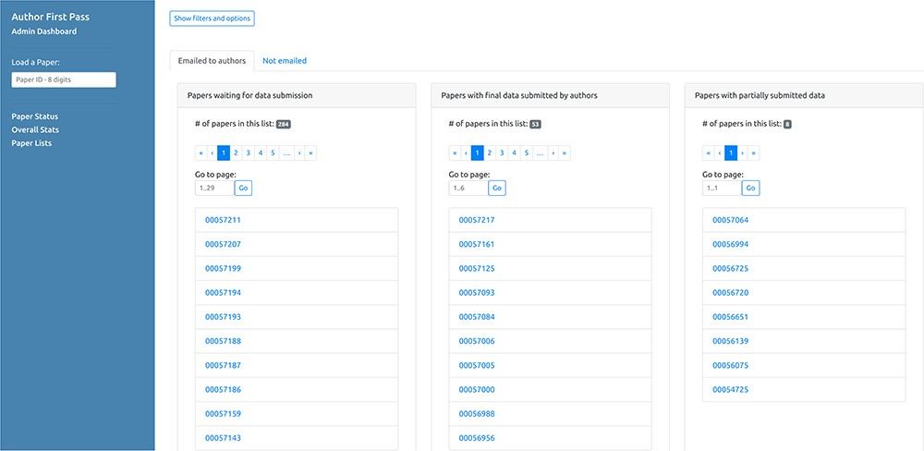
Figure 7 Curator dashboard - Paper lists. This page of the curator dashboard contains links to the feedback form for ...
Notes:
Figure 7 Curator dashboard - Paper lists. This page of the curator dashboard contains links to the feedback form for authors for all papers processed by the pipeline, divided into different groups depending on their status (i.e. processed but not submitted, full submissions and partial submissions).
Unless provided in the caption above, the following copyright applies to the content of this slide: © The Author(s) 2020. Published by Oxford University Press.This is an Open Access article distributed under the terms of the Creative Commons Attribution License (http://creativecommons.org/licenses/by/4.0/), which permits unrestricted reuse, distribution, and reproduction in any medium, provided the original work is properly cited.

Slide 8
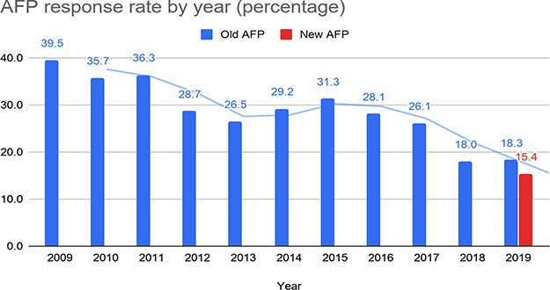
Figure 8 Response rate for the old and the new AFP.
Notes:
Figure 8 Response rate for the old and the new AFP.
Unless provided in the caption above, the following copyright applies to the content of this slide: © The Author(s) 2020. Published by Oxford University Press.This is an Open Access article distributed under the terms of the Creative Commons Attribution License (http://creativecommons.org/licenses/by/4.0/), which permits unrestricted reuse, distribution, and reproduction in any medium, provided the original work is properly cited.

Slide 9
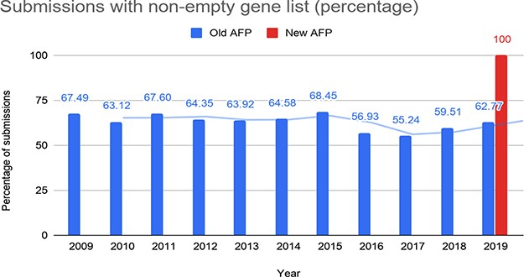
Figure 9 Percentage of submissions with at least one gene reported through the old and the new AFP.
Notes:
Figure 9 Percentage of submissions with at least one gene reported through the old and the new AFP.
Unless provided in the caption above, the following copyright applies to the content of this slide: © The Author(s) 2020. Published by Oxford University Press.This is an Open Access article distributed under the terms of the Creative Commons Attribution License (http://creativecommons.org/licenses/by/4.0/), which permits unrestricted reuse, distribution, and reproduction in any medium, provided the original work is properly cited.

Slide 10
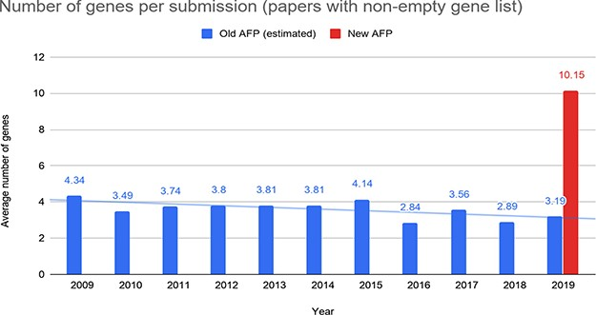
Figure 10 Number of genes reported by the authors per submission through the old and the new AFP forms.
Notes:
Figure 10 Number of genes reported by the authors per submission through the old and the new AFP forms.
Unless provided in the caption above, the following copyright applies to the content of this slide: © The Author(s) 2020. Published by Oxford University Press.This is an Open Access article distributed under the terms of the Creative Commons Attribution License (http://creativecommons.org/licenses/by/4.0/), which permits unrestricted reuse, distribution, and reproduction in any medium, provided the original work is properly cited.

