Slide 1
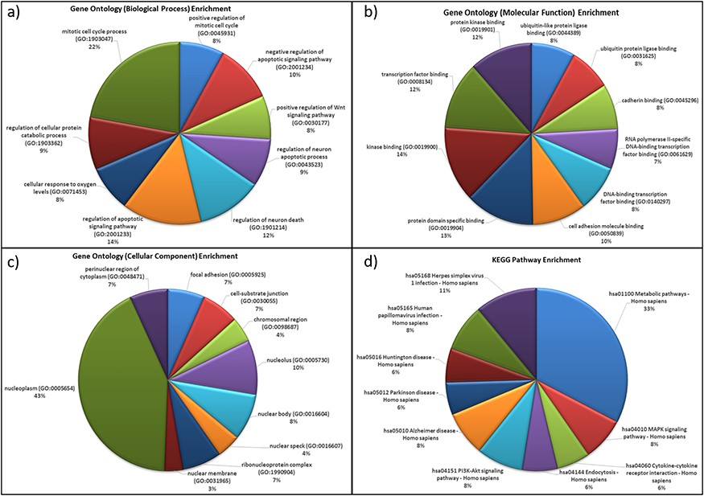
Figure 5. Functional characterization of differentially expressed HA miRNA–targets (a) GO: biological processes. (b) ...
Notes:
Figure 5. Functional characterization of differentially expressed HA miRNA–targets (a) GO: biological processes. (b) GO: molecular functions (c) GO: cellular compartment and (d) KEGG pathway enrichment.
Unless provided in the caption above, the following copyright applies to the content of this slide: © The Author(s) 2020. Published by Oxford University Press.This is an Open Access article distributed under the terms of the Creative Commons Attribution License (http://creativecommons.org/licenses/by/4.0/), which permits unrestricted reuse, distribution, and reproduction in any medium, provided the original work is properly cited.

