Slide 1
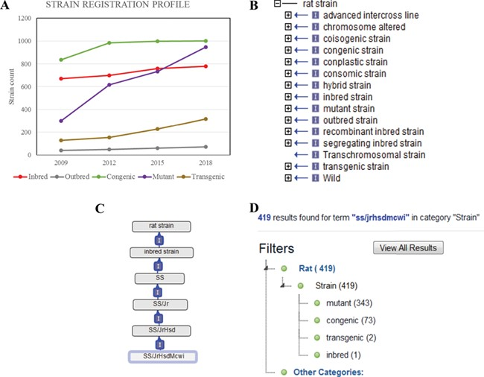
Figure 1 (A) The total counts of the registered rat strains at RGD over a 10-year period. Five strain types, inbred, ...
Notes:
Figure 1 (A) The total counts of the registered rat strains at RGD over a 10-year period. Five strain types, inbred, outbred, congenic, mutant and transgenic strains, are selected to show the growth trends among different strain types. (B) The 15 high-level nodes of the RS Ontology. (C) The ontological tree of SS/JrHsdMcwi. (D) Using SS/JrHsdMcwi as a search keyword to retrieve strains related to this strain. The numbers in parentheses show the total number and the breakdown numbers for the strain types.
Unless provided in the caption above, the following copyright applies to the content of this slide: © The Author(s) 2019. Published by Oxford University Press.This is an Open Access article distributed under the terms of the Creative Commons Attribution License (http://creativecommons.org/licenses/by/4.0/), which permits unrestricted reuse, distribution, and reproduction in any medium, provided the original work is properly cited.

