Slide 1
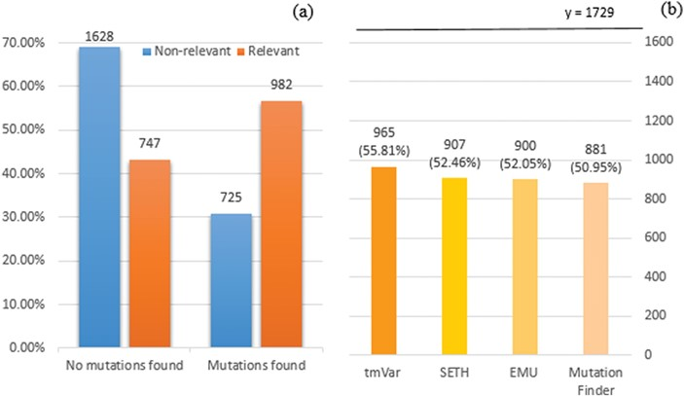
Figure 1 (a) Distribution of documents having a mutation identified by at least one of four mutation detection tools. ...
Notes:
Figure 1 (a) Distribution of documents having a mutation identified by at least one of four mutation detection tools. Relevant: documents labelled as relevant for PPIm in the training set, otherwise non-relevant. Mutations found: documents have a mutation mention identified by at least one of the tools, otherwise no mutations found. The y-axis corresponds to the proportion relative to the relevant or non-relevant document collections, respectively. For instance, almost 70% of non-relevant documents (1628 out of 2353) have no detected mutation mentions. (b) Distribution of relevant documents having mutations identified by individual tools; y = 1729 is the total number of relevant documents, in which we would expect to have at least one mutation mentioned per task definition.
Unless provided in the caption above, the following copyright applies to the content of this slide: © The Author(s) 2018. Published by Oxford University Press.This is an Open Access article distributed under the terms of the Creative Commons Attribution License (http://creativecommons.org/licenses/by/4.0/), which permits unrestricted reuse, distribution, and reproduction in any medium, provided the original work is properly cited.

