Slide 1
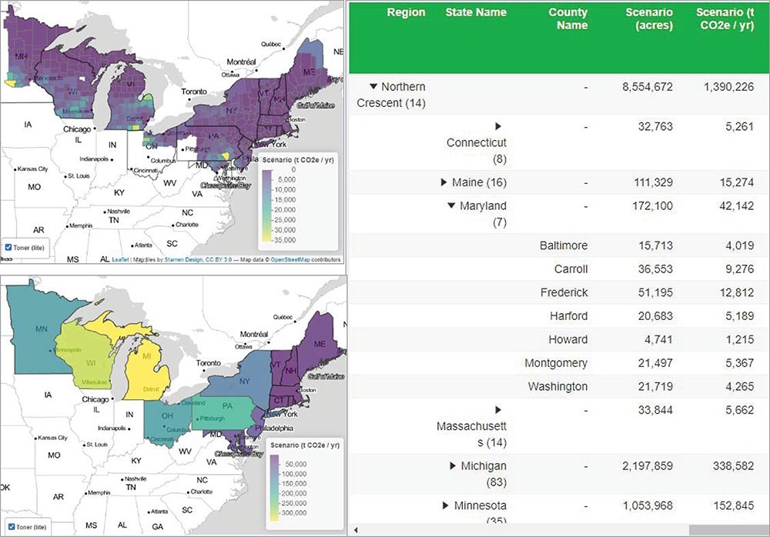
Figure 5. Map of the Northern Crescent region viewed at county and state pooling levels with tabular data reported at ...
Notes:
Figure 5. Map of the Northern Crescent region viewed at county and state pooling levels with tabular data reported at the county level. Scenario settings included adoption of 25% available cropland adopting a cover crop (20% legume and 80% non-legume) and assumed that 2017 acres in cover crop were composed of 10% legume and 90% non-legume.
Unless provided in the caption above, the following copyright applies to the content of this slide: Published by Oxford University Press 2022. This work is written by (a) US Government employee(s) and is in the public domain in the US.This work is written by (a) US Government employee(s) and is in the public domain in the US.

