Slide 1
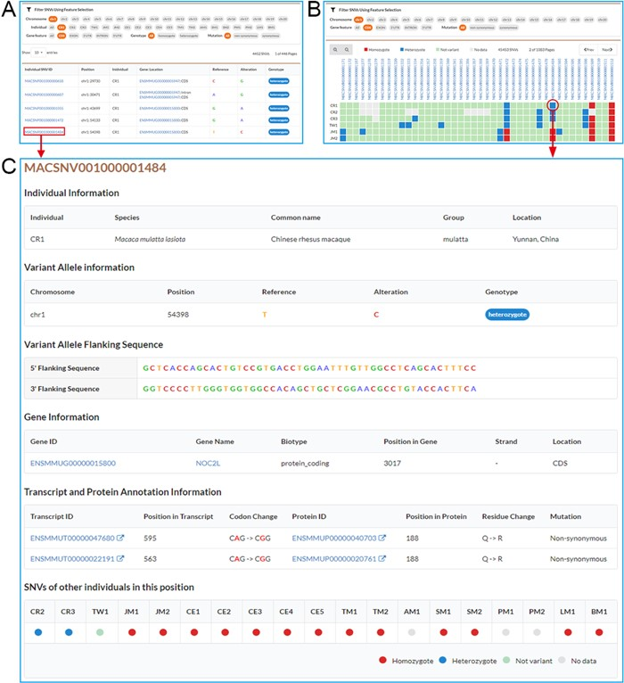
Figure 2 Screenshots of SNV browse pages. A. Individual SNVs’ browse page contains the filtration pane with the SNV ...
Notes:
Figure 2 Screenshots of SNV browse pages. A. Individual SNVs’ browse page contains the filtration pane with the SNV result table below. By using the filtration pane, users can filter SNV data and get a list of relevant SNVs. B. Non-redundant SNVs’ browse page. Comparative map of genotypes in each individual is indicated by colored and filled circles in SNV result table. C. Detailed information for an SNV.
Unless provided in the caption above, the following copyright applies to the content of this slide: © The Author(s) 2020. Published by Oxford University Press.This is an Open Access article distributed under the terms of the Creative Commons Attribution License (http://creativecommons.org/licenses/by/4.0/), which permits unrestricted reuse, distribution, and reproduction in any medium, provided the original work is properly cited.

