Slide 1
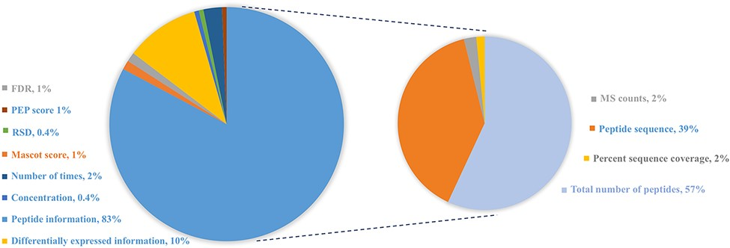
Figure 3. Distribution of protein abundance methods in HBFP database based on a number of original quantitative ...
Notes:
Figure 3. Distribution of protein abundance methods in HBFP database based on a number of original quantitative analysis methods from the original literature studies. Note that the sum of protein abundance is not 100% since not all of the literature studies provide quantitative analysis information.
Unless provided in the caption above, the following copyright applies to the content of this slide: © The Author(s) 2021. Published by Oxford University Press.This is an Open Access article distributed under the terms of the Creative Commons Attribution License (https://creativecommons.org/licenses/by/4.0/), which permits unrestricted reuse, distribution, and reproduction in any medium, provided the original work is properly cited.

