Slide 1
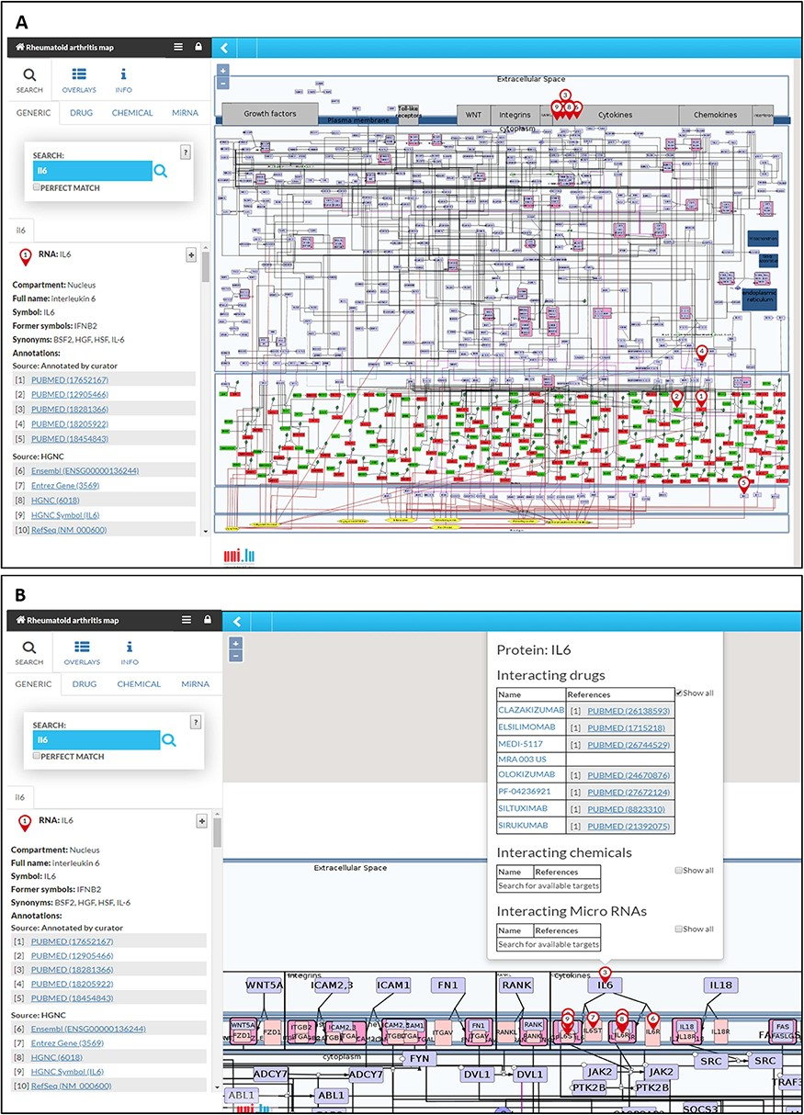
Figure 3 The RA map in MINERVA platform. (A) Users can use the search box to type in the element of interest. The ...
Notes:
Figure 3 The RA map in MINERVA platform. (A) Users can use the search box to type in the element of interest. The resulting element shows up as pins on the map. Corresponding annotations of the searched element, like HGNC, Entrez Gene, RefSeq and Ensembl identifiers are displayed on the left panel along with the PubMed identifiers of the manually curated annotations. (B) Further clicking on the pin will display additional information about interacting drugs, chemicals and microRNAs for the element.
Unless provided in the caption above, the following copyright applies to the content of this slide: © The Author(s) 2020. Published by Oxford University Press.This is an Open Access article distributed under the terms of the Creative Commons Attribution License (http://creativecommons.org/licenses/by/4.0/), which permits unrestricted reuse, distribution, and reproduction in any medium, provided the original work is properly cited.

