Slide 1
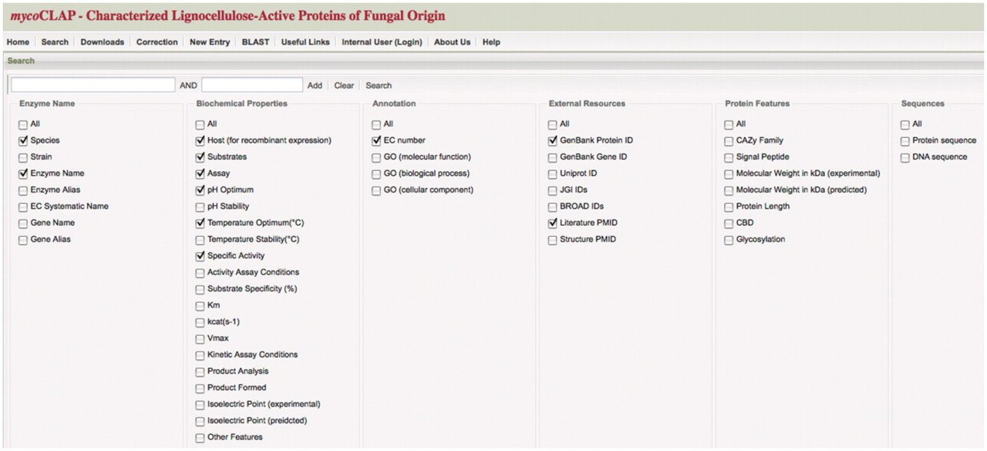
Figure 1. mycoCLAP search page. The main search page from mycoCLAP is shown here. Keywords such as enzyme activity, ...
Notes:
Figure 1. mycoCLAP search page. The main search page from mycoCLAP is shown here. Keywords such as enzyme activity, glycoside hydrolase family or a substrate name can be entered as search terms. Leaving the field blank and clicking on ‘search’ allows a user to browse the database. The information recorded during the curation process has been divided into six categories shown here; Enzyme Name, Biochemical Properties, Annotation, External Resources, Protein Features and Sequence. By checking boxes under these categories a user can determine which types of information will be displayed on the results page. The default settings are shown here. The tabs along the top allow quick and easy navigation through all of mycoCLAP’s features.
Unless provided in the caption above, the following copyright applies to the content of this slide: © The Author(s) 2011. Published by Oxford University Press.This is Open Access article distributed under the terms of the Creative Commons Attribution Non-Commercial License (http://creativecommons.org/licenses/by-nc/2.5), which permits unrestricted non-commercial use, distribution, and reproduction in any medium, provided the original work is properly cited.

