Slide 1
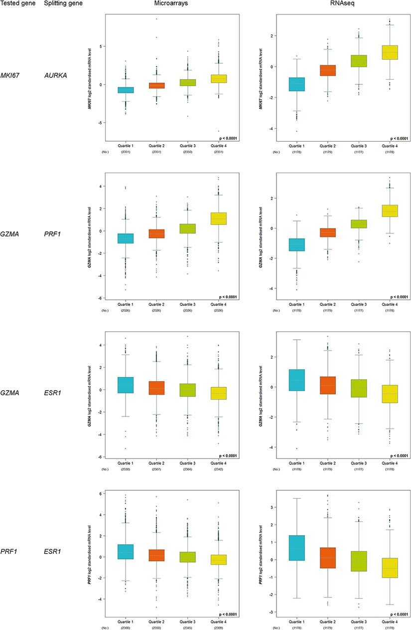
Figure 3. Customized expression analysis results of four demonstrative gene pairs (tested gene, splitting gene/quartile ...
Notes:
Figure 3. Customized expression analysis results of four demonstrative gene pairs (tested gene, splitting gene/quartile criterion): (MKI67, AURKA); (GZMA, PRF1); (GZMA, ESR1) and (PRF1, ESR1).
Unless provided in the caption above, the following copyright applies to the content of this slide: © The Author(s) 2021. Published by Oxford University Press.This is an Open Access article distributed under the terms of the Creative Commons Attribution License (http://creativecommons.org/licenses/by/4.0/), which permits unrestricted reuse, distribution, and reproduction in any medium, provided the original work is properly cited.

