Slide 1
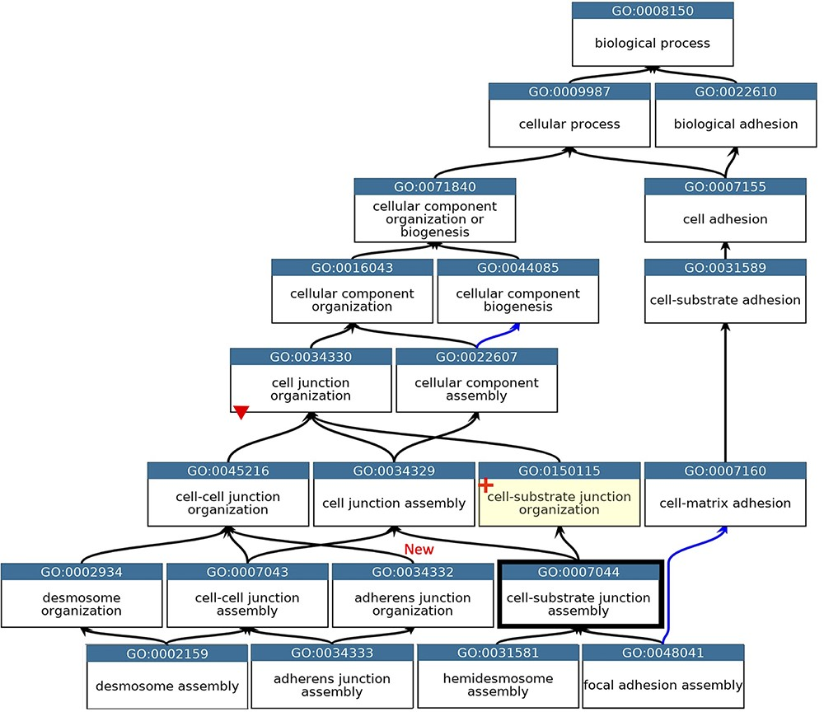
Figure 2. GO describing the biological process cell junction assembly. A subset of the GO terms describing the assembly ...
Notes:
Figure 2. GO describing the biological process cell junction assembly. A subset of the GO terms describing the assembly of a selection of cell junctions modified to align with the revised cellular component ontology. GO terms are listed in separate nodes and the descendant relationships are indicated by black and blue arrows, for ‘is_a’ and ‘part_of’ relations, respectively. The GO term identifiers and names are included in each node. The yellow highlighted node with a red cross indicates the new GO term, GO:0150115 ‘cell-substrate junction organization’ and its associated new relations. The thick node outline indicates that the GO term ‘cell-substrate adherens junction assembly’ was merged into ‘cell-substrate junction assembly’. A red triangle indicates the removal of an ‘is_a’ parent relation between the GO:0034330 ‘cell junction organization’ and GO:0034332 ‘adherens junction organisation’ terms. An added ‘is_a’ relation between GO:0034332 ‘adherens junction organisation’ and GO:0045216 ‘cell-cell junction organization’ is indicated ‘New’. Screenshot of the GO taken from QuickGO (11).
Unless provided in the caption above, the following copyright applies to the content of this slide: © The Author(s) 2021. Published by Oxford University Press.This is an Open Access article distributed under the terms of the Creative Commons Attribution License (https://creativecommons.org/licenses/by/4.0/), which permits unrestricted reuse, distribution, and reproduction in any medium, provided the original work is properly cited.

