Slide 1
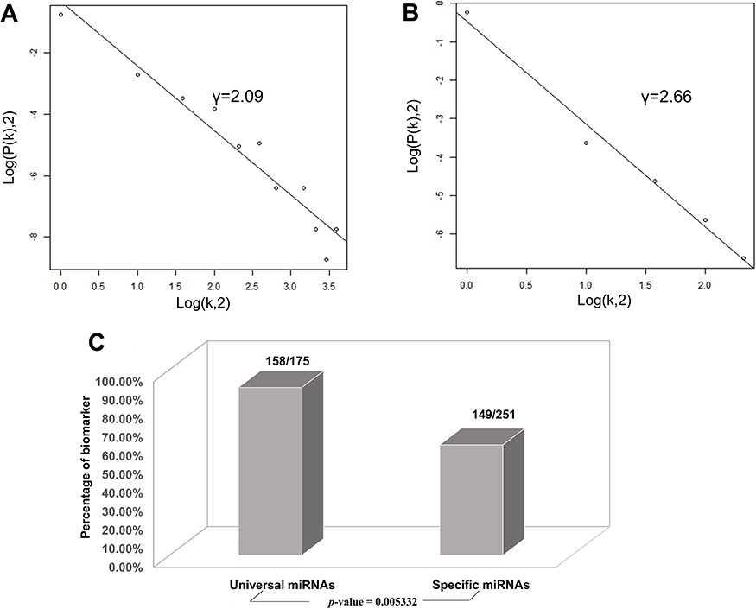
Figure 5 Correlations and distribution of miRNAs and lncRNAs related to CVDs. The x-coordinate K is the number of ...
Notes:
Figure 5 Correlations and distribution of miRNAs and lncRNAs related to CVDs. The x-coordinate K is the number of related CVDs, and the y-coordinate is the proportion of ncRNAs (miRNAs or lncRNAs). (A) Scale-free feature of lncRNAs related to CVDs. (B) Scale-free feature of lncRNAs related to CVDs. (C) Percentage of biomarkers in universal miRNAs and specific miRNAs.
Unless provided in the caption above, the following copyright applies to the content of this slide: © The Author(s) 2020. Published by Oxford University Press.This is an Open Access article distributed under the terms of the Creative Commons Attribution License (http://creativecommons.org/licenses/by/4.0/), which permits unrestricted reuse, distribution, and reproduction in any medium, provided the original work is properly cited.

