Slide 1
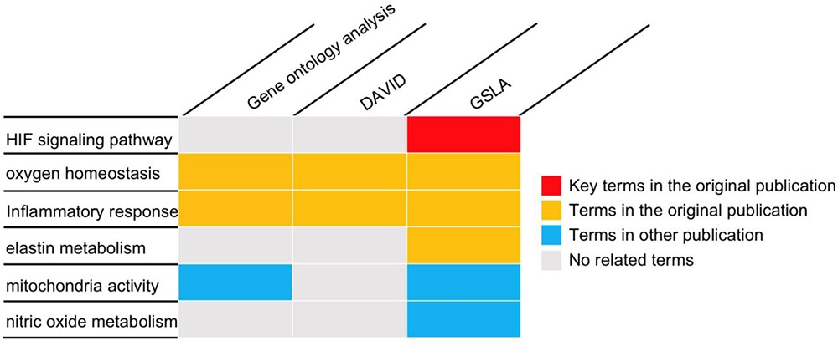
Figure 5. The gene set annotations produced by PRID/GSLA. The annotations produced by GSLA are more comprehensive and ...
Notes:
Figure 5. The gene set annotations produced by PRID/GSLA. The annotations produced by GSLA are more comprehensive and inspire further mechanism studies. We performed DAVID and gene ontology analysis for comparison.
Unless provided in the caption above, the following copyright applies to the content of this slide: © The Author(s) 2020. Published by Oxford University Press.This is an Open Access article distributed under the terms of the Creative Commons Attribution License (http://creativecommons.org/licenses/by/4.0/), which permits unrestricted reuse, distribution, and reproduction in any medium, provided the original work is properly cited.

