Slide 1
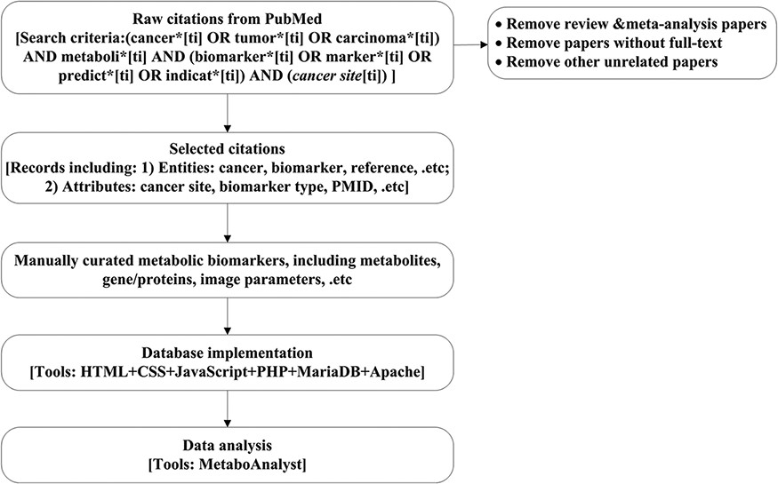
Figure 1. Work flow chart. Here, the cancer site will be specific to cancer site searched, e.g. breast, prostate and ...
Notes:
Figure 1. Work flow chart. Here, the cancer site will be specific to cancer site searched, e.g. breast, prostate and lung. Details for search criteria and result are shown in supplementary file 1.
Unless provided in the caption above, the following copyright applies to the content of this slide: © The Author(s) 2021. Published by Oxford University Press.This is an Open Access article distributed under the terms of the Creative Commons Attribution License (http://creativecommons.org/licenses/by/4.0/), which permits unrestricted reuse, distribution, and reproduction in any medium, provided the original work is properly cited.

Slide 2
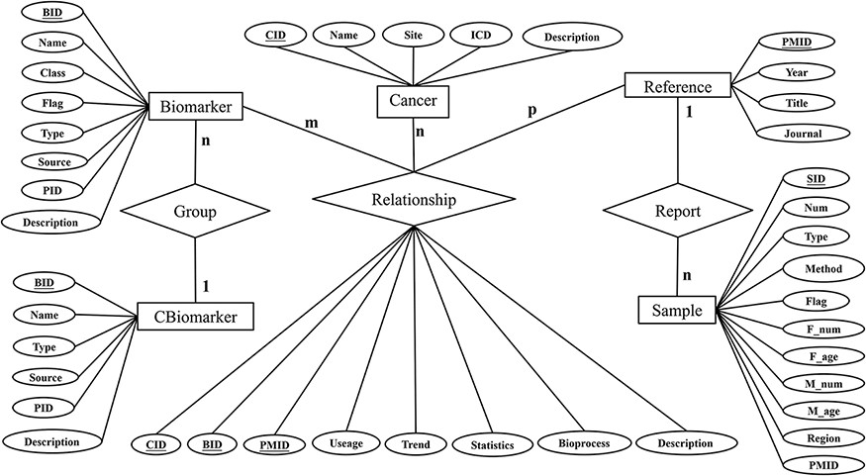
Figure 2. Entity-Relation diagram.
Notes:
Figure 2. Entity-Relation diagram.
Unless provided in the caption above, the following copyright applies to the content of this slide: © The Author(s) 2021. Published by Oxford University Press.This is an Open Access article distributed under the terms of the Creative Commons Attribution License (http://creativecommons.org/licenses/by/4.0/), which permits unrestricted reuse, distribution, and reproduction in any medium, provided the original work is properly cited.

Slide 3
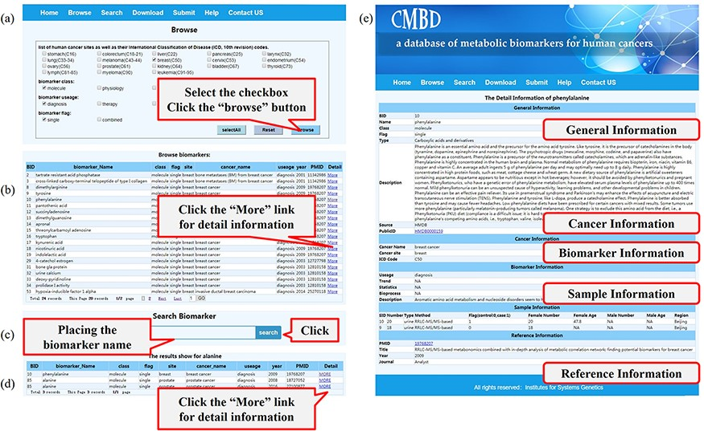
Figure 3. A screenshot of the utility of CMBD. (a) The browse page, biomarkers are classified by their site, class, ...
Notes:
Figure 3. A screenshot of the utility of CMBD. (a) The browse page, biomarkers are classified by their site, class, usage and flag reported in the literature; (b) the list of items matching the filter criteria; (c) search page; (d) the list of items matching fuzzy retrieval; (e) detail information about biomarkers.
Unless provided in the caption above, the following copyright applies to the content of this slide: © The Author(s) 2021. Published by Oxford University Press.This is an Open Access article distributed under the terms of the Creative Commons Attribution License (http://creativecommons.org/licenses/by/4.0/), which permits unrestricted reuse, distribution, and reproduction in any medium, provided the original work is properly cited.

Slide 4
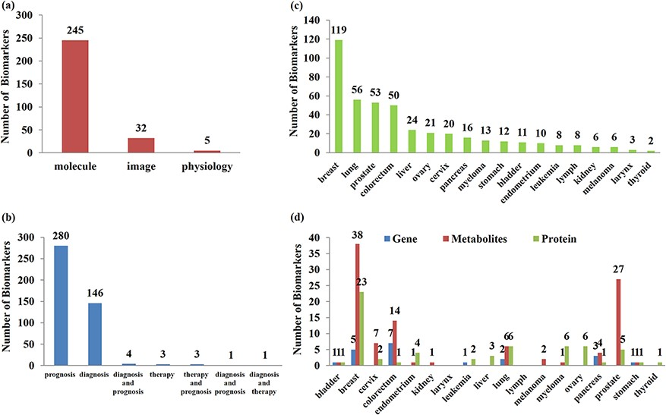
Figure 4. Classification and statistics of biomarkers. (a) Type of biomarkers; (b) usage distribution of biomarkers; ...
Notes:
Figure 4. Classification and statistics of biomarkers. (a) Type of biomarkers; (b) usage distribution of biomarkers; (c) site distribution of biomarkers; (d) classification distribution of single molecular biomarkers in different sites.
Unless provided in the caption above, the following copyright applies to the content of this slide: © The Author(s) 2021. Published by Oxford University Press.This is an Open Access article distributed under the terms of the Creative Commons Attribution License (http://creativecommons.org/licenses/by/4.0/), which permits unrestricted reuse, distribution, and reproduction in any medium, provided the original work is properly cited.

Slide 5
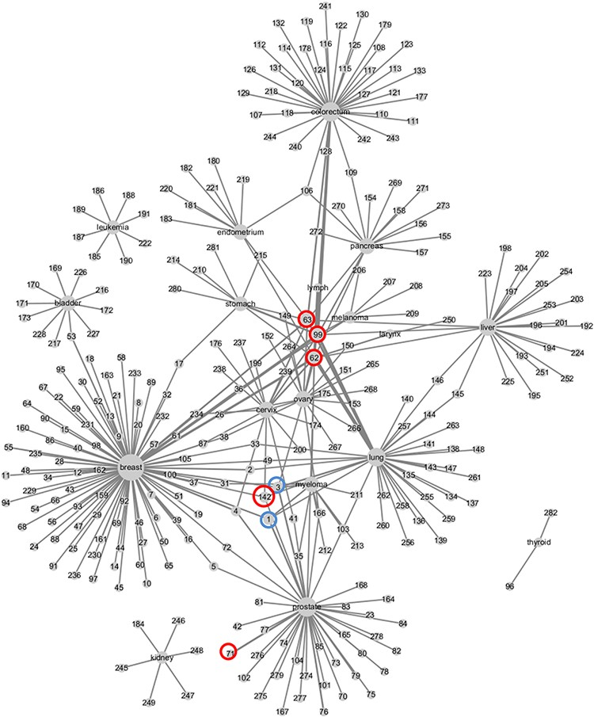
Figure 5. Weighed network of cancers and metabolic biomarkers. Nodes represent cancers and biomarkers, labeled by ...
Notes:
Figure 5. Weighed network of cancers and metabolic biomarkers. Nodes represent cancers and biomarkers, labeled by cancer site and biomarkers’ ID in CMBD. Cancer node and biomarker node are linked by an edge if they are reported in a literature. The size of cancer node represents the number of biomarker nodes linked to it, and the width of edge represents the frequencies that the cancer and the biomarker are reported in literatures.
Unless provided in the caption above, the following copyright applies to the content of this slide: © The Author(s) 2021. Published by Oxford University Press.This is an Open Access article distributed under the terms of the Creative Commons Attribution License (http://creativecommons.org/licenses/by/4.0/), which permits unrestricted reuse, distribution, and reproduction in any medium, provided the original work is properly cited.

