Slide 1
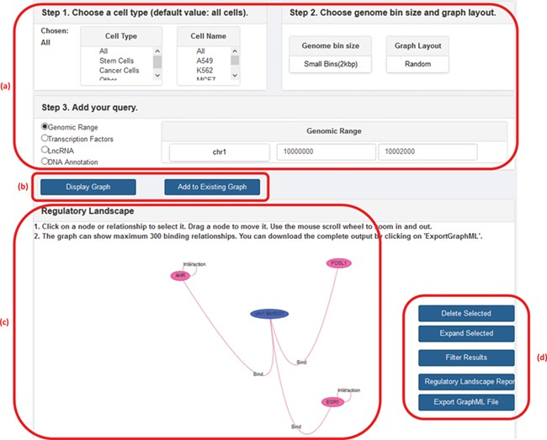
Figure 2 A screenshot of GREG’s web platform (basic mode). (a) Input data: cell type, DNA bin size and query (genomic ...
Notes:
Figure 2 A screenshot of GREG’s web platform (basic mode). (a) Input data: cell type, DNA bin size and query (genomic range, transcription factor, lncRNA or DNA annotation). (b) Options to run query: either display new graph or add query to existing graph. (c) Results window: data associated with each node or relationship (see Table 1) can be visualized by hovering over the graph. (d) Options to manage results: delete or expand selected nodes or relationships, filter results by a given type of relationship, print a summary report or export a graph to a graph format.
Unless provided in the caption above, the following copyright applies to the content of this slide: © The Author(s) 2020. Published by Oxford University Press.This is an Open Access article distributed under the terms of the Creative Commons Attribution License (http://creativecommons.org/licenses/by/4.0/), which permits unrestricted reuse, distribution, and reproduction in any medium, provided the original work is properly cited.

