Slide 1
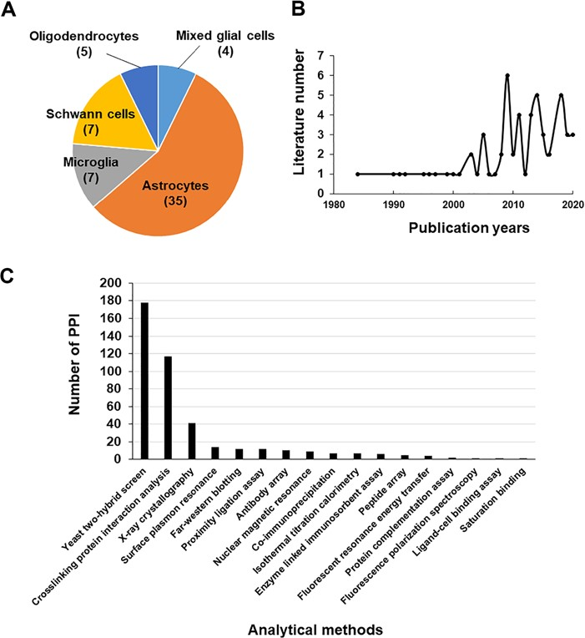
Figure 1 Literature used in the Gliome database. (A, B) The distribution of the literature according to glial cell ...
Notes:
Figure 1 Literature used in the Gliome database. (A, B) The distribution of the literature according to glial cell type (A) or the publication year (B). (C) The number of PPIs classified by analytical methods.
Unless provided in the caption above, the following copyright applies to the content of this slide: © The Author(s) 2020. Published by Oxford University Press.This is an Open Access article distributed under the terms of the Creative Commons Attribution License (http://creativecommons.org/licenses/by/4.0/), which permits unrestricted reuse, distribution, and reproduction in any medium, provided the original work is properly cited.

Slide 2
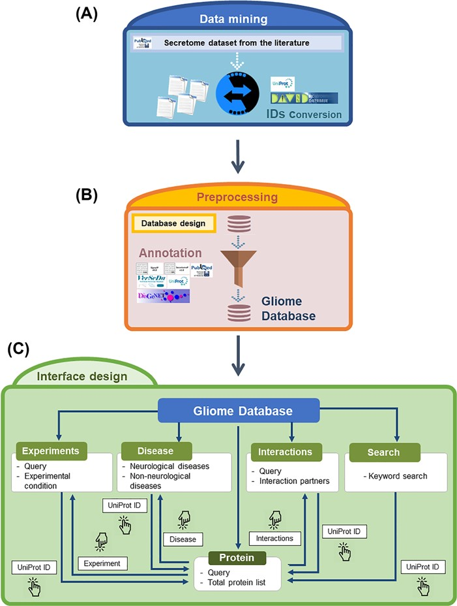
Figure 2 Overview of the Gliome database. (A) Data mining step to obtain the glia secretome information. The obtained ...
Notes:
Figure 2 Overview of the Gliome database. (A) Data mining step to obtain the glia secretome information. The obtained protein names are converted into UniProt ID. (B) Information is entered according to the database format so that users can browse various types of information. At this step, various external databases were used alongside ours. (C) A diagram of navigation at the Gliome database. The protein identifiers of any types were converted into official gene name/UniProt ID.
Unless provided in the caption above, the following copyright applies to the content of this slide: © The Author(s) 2020. Published by Oxford University Press.This is an Open Access article distributed under the terms of the Creative Commons Attribution License (http://creativecommons.org/licenses/by/4.0/), which permits unrestricted reuse, distribution, and reproduction in any medium, provided the original work is properly cited.

Slide 3
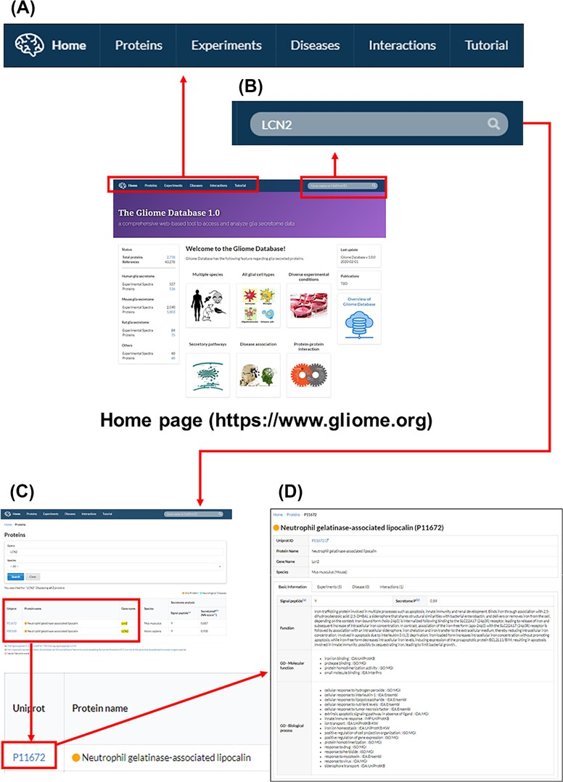
Figure 3 The main page and appearance of the Gliome database. (A) Main tabs, (B) quick search window, (C) protein ...
Notes:
Figure 3 The main page and appearance of the Gliome database. (A) Main tabs, (B) quick search window, (C) protein list, (D) protein information. When a user enters a protein name, such as ‘LCN2’, on the quick search window, the page of LCN2 protein appears. By clicking the UniProt ID, the relevant detailed information can be obtained.
Unless provided in the caption above, the following copyright applies to the content of this slide: © The Author(s) 2020. Published by Oxford University Press.This is an Open Access article distributed under the terms of the Creative Commons Attribution License (http://creativecommons.org/licenses/by/4.0/), which permits unrestricted reuse, distribution, and reproduction in any medium, provided the original work is properly cited.

Slide 4
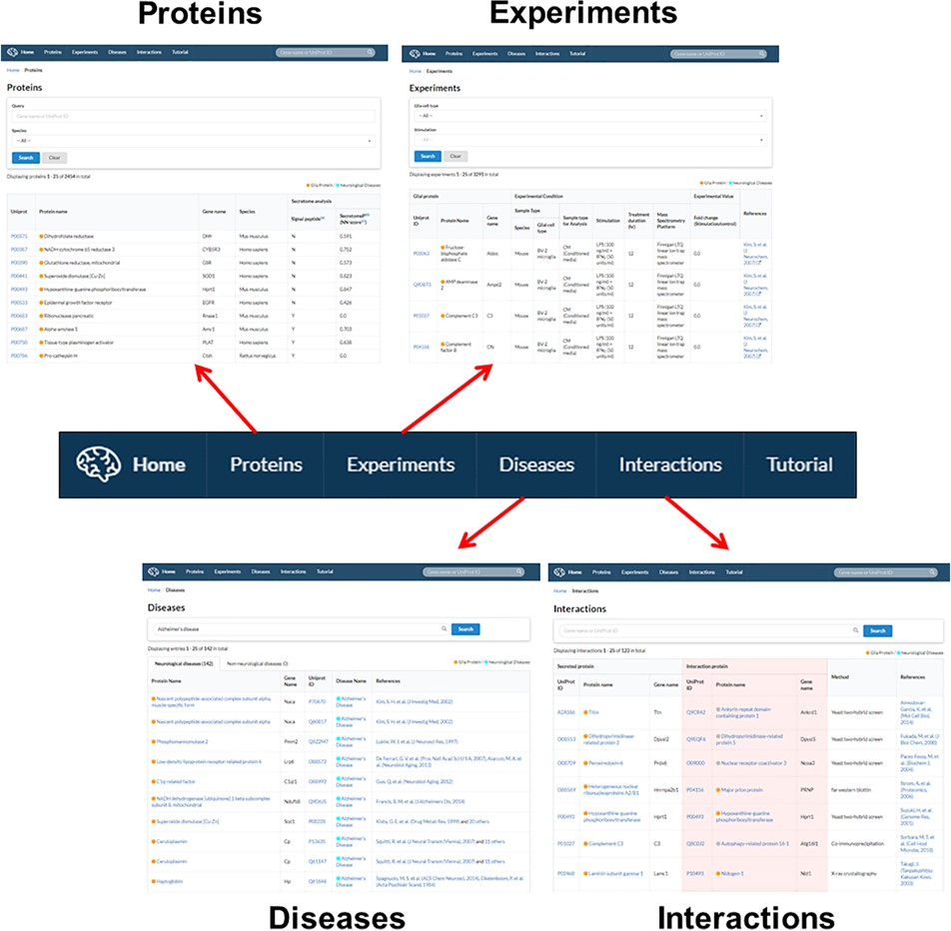
Figure 4 Gliome database navigation. The main tab at the top of the homepage is hyperlinked with four major ...
Notes:
Figure 4 Gliome database navigation. The main tab at the top of the homepage is hyperlinked with four major informative browsers including protein information (‘Proteins’), experiments (‘Experiments’), associated diseases (‘Diseases’) and PPI (‘Interactions’).
Unless provided in the caption above, the following copyright applies to the content of this slide: © The Author(s) 2020. Published by Oxford University Press.This is an Open Access article distributed under the terms of the Creative Commons Attribution License (http://creativecommons.org/licenses/by/4.0/), which permits unrestricted reuse, distribution, and reproduction in any medium, provided the original work is properly cited.

