Slide 1
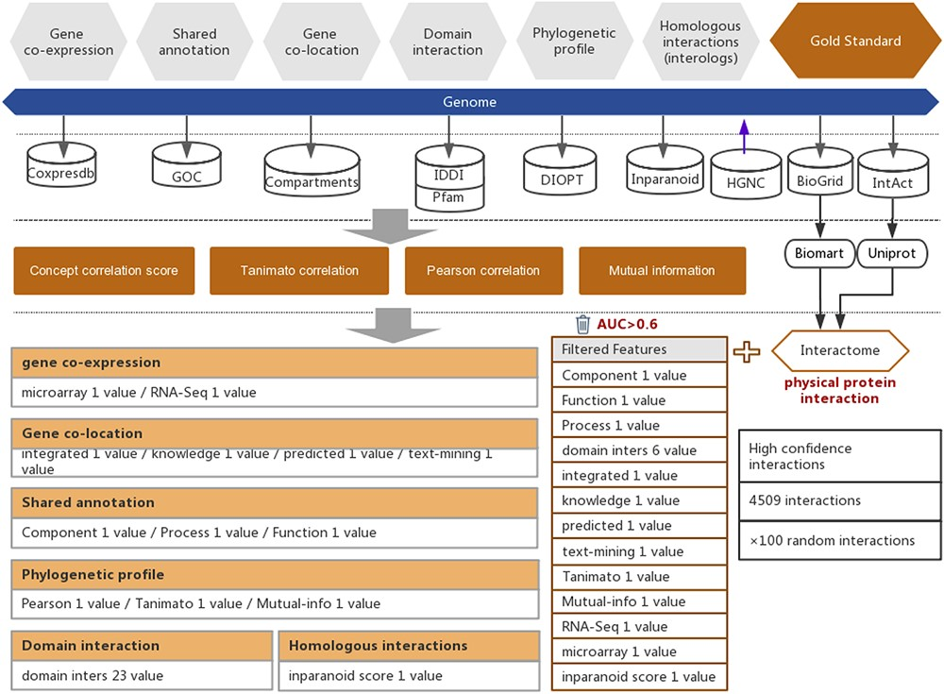
Figure 1. Workflow of the functional interaction prediction between human genes. High-quality experimentally reported ...
Notes:
Figure 1. Workflow of the functional interaction prediction between human genes. High-quality experimentally reported protein interactions were integrated from two databases and were used as positive examples. Six types of functional association evidence from seven databases were collected to infer putative functional interactions. A total of 18 high-quality feature values were selected from 36 feature values that characterize this evidence with different mathematical representations. Random gene pairs with all positive examples removed were used as negative examples. The number of negative examples was 100 times the number of positive examples.
Unless provided in the caption above, the following copyright applies to the content of this slide: © The Author(s) 2021. Published by Oxford University Press.This is an Open Access article distributed under the terms of the Creative Commons Attribution License (http://creativecommons.org/licenses/by/4.0/), which permits unrestricted reuse, distribution, and reproduction in any medium, provided the original work is properly cited.

Slide 2
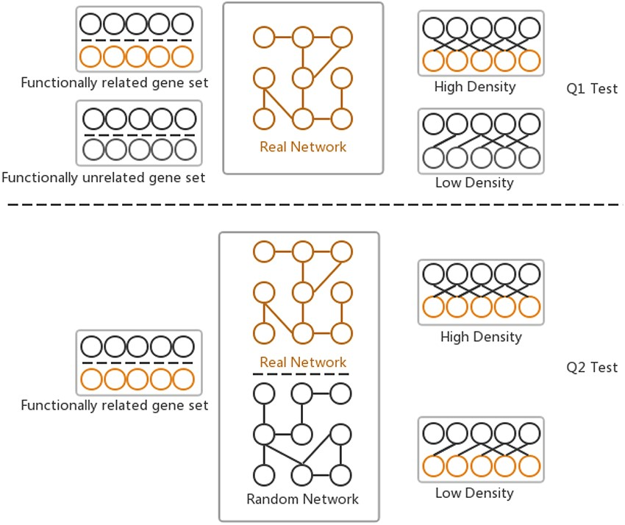
Figure 2. Two hypotheses of GSLA used to ensure that the identified significant functional associations between two ...
Notes:
Figure 2. Two hypotheses of GSLA used to ensure that the identified significant functional associations between two gene sets are biologically meaningful. Q1 tests whether the density of functional associations between two biologically meaningful gene sets is higher than that of random gene pairs. Q2 tests whether the strong functional associations observed between two gene sets can be observed only from the biologically correct network rather than from any random interactomes.
Unless provided in the caption above, the following copyright applies to the content of this slide: © The Author(s) 2021. Published by Oxford University Press.This is an Open Access article distributed under the terms of the Creative Commons Attribution License (http://creativecommons.org/licenses/by/4.0/), which permits unrestricted reuse, distribution, and reproduction in any medium, provided the original work is properly cited.

Slide 3
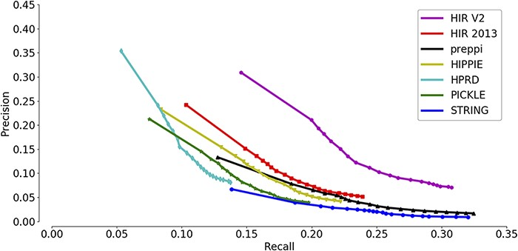
Figure 3. Assessment of the capabilities of seven interactomes to group functionally associated genes together. The ...
Notes:
Figure 3. Assessment of the capabilities of seven interactomes to group functionally associated genes together. The precision-recall curves of gene function prediction using different interactomes are illustrated. Precision measures the proportion of correct annotations identified by an interactome, while recall measures the proportion of new annotations that are identified by an interactome.
Unless provided in the caption above, the following copyright applies to the content of this slide: © The Author(s) 2021. Published by Oxford University Press.This is an Open Access article distributed under the terms of the Creative Commons Attribution License (http://creativecommons.org/licenses/by/4.0/), which permits unrestricted reuse, distribution, and reproduction in any medium, provided the original work is properly cited.

Slide 4
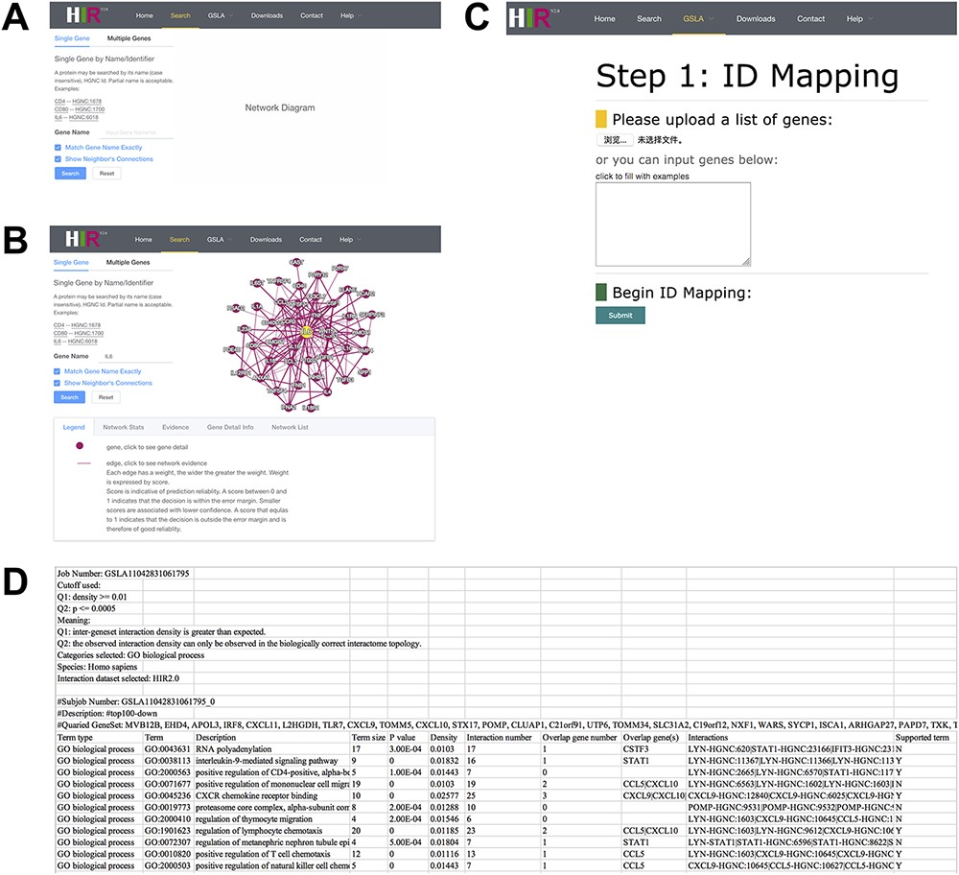
Figure 4. Interface of the HIR V2 and GSLA. (A) Two search options in the HIR V2. (B) Search result page. A right click ...
Notes:
Figure 4. Interface of the HIR V2 and GSLA. (A) Two search options in the HIR V2. (B) Search result page. A right click on the edge will show the interaction details. (C) Interface of the GSLA. (D) Results of a GSLA task.
Unless provided in the caption above, the following copyright applies to the content of this slide: © The Author(s) 2021. Published by Oxford University Press.This is an Open Access article distributed under the terms of the Creative Commons Attribution License (http://creativecommons.org/licenses/by/4.0/), which permits unrestricted reuse, distribution, and reproduction in any medium, provided the original work is properly cited.

Slide 5
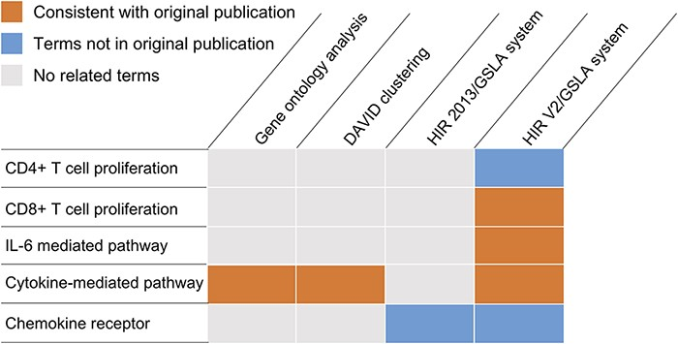
Figure 5. Functional interpretations produced by the HIR V2/GSLA. Compared to GO enrichment analysis and DAVID, the ...
Notes:
Figure 5. Functional interpretations produced by the HIR V2/GSLA. Compared to GO enrichment analysis and DAVID, the annotations produced by GSLA are more comprehensive and more accurate.
Unless provided in the caption above, the following copyright applies to the content of this slide: © The Author(s) 2021. Published by Oxford University Press.This is an Open Access article distributed under the terms of the Creative Commons Attribution License (http://creativecommons.org/licenses/by/4.0/), which permits unrestricted reuse, distribution, and reproduction in any medium, provided the original work is properly cited.

