Slide 1
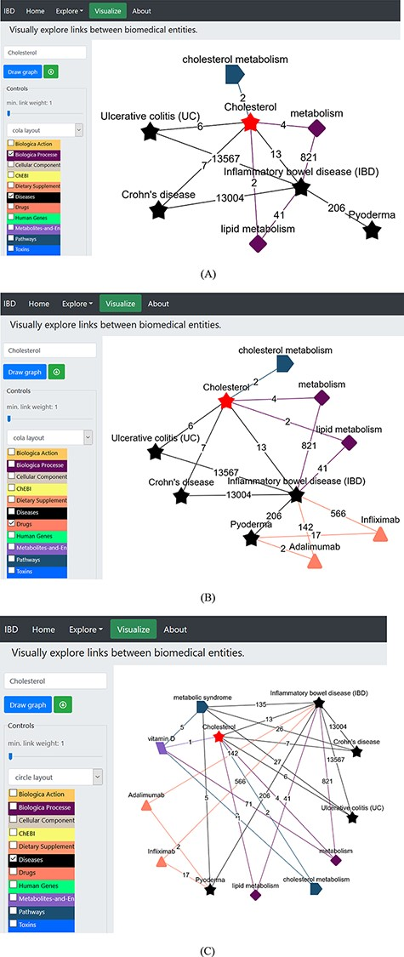
Figure 4. (A) Network construction to identify the direct relationship between pyoderma and IBD through PubMed ...
Notes:
Figure 4. (A) Network construction to identify the direct relationship between pyoderma and IBD through PubMed abstracts. (B) Illustrates the construction of network to identify the link between pyoderma and IBD though common drugs used for treatment of both diseases. The orange triangles represent the ‘Drugs’ dictionary used to find drugs commonly used for treatment of both PG and IBD. (C) Illustrates the link between pyoderma and cholesterol through metabolic pathways. The red star represents the initial searched term ‘cholesterol’. The black stars represent the ‘Diseases’ dictionary. The purple-coloured diamond represents the ‘Biological Processes’ dictionary. The rectangular light purple colour represents the ‘Metabolites and Enzymes’ dictionary. The coloured edges represent the colours of their respective dictionaries. The number shown on each edge showcases the number of publications that link the associated nodes.
Unless provided in the caption above, the following copyright applies to the content of this slide: © The Author(s) 2021. Published by Oxford University Press.This is an Open Access article distributed under the terms of the Creative Commons Attribution License (http://creativecommons.org/licenses/by/4.0/), which permits unrestricted reuse, distribution, and reproduction in any medium, provided the original work is properly cited.

