Slide 1
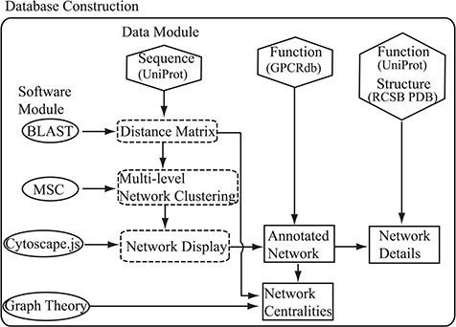
Figure 1 Flowchart of the construction of the SeQuery. Hexagons denote the source databases, and ovals denote ...
Notes:
Figure 1 Flowchart of the construction of the SeQuery. Hexagons denote the source databases, and ovals denote computational methods. Intermediate data derived during computation is represented by dashed squares, while the generated graphs for visualization are represented by solid squares.
Unless provided in the caption above, the following copyright applies to the content of this slide: © The Author(s) 2019. Published by Oxford University Press.This is an Open Access article distributed under the terms of the Creative Commons Attribution License (http://creativecommons.org/licenses/by/4.0/), which permits unrestricted reuse, distribution, and reproduction in any medium, provided the original work is properly cited.

