Slide 1
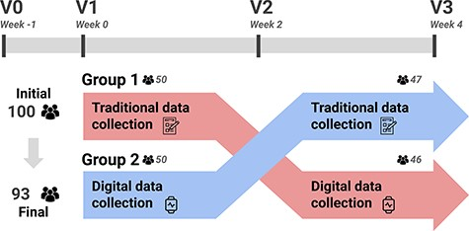
Figure 2. A summary of the acquisition protocol considered in AI4FoodDB. The intervention followed a cross-over design. ...
Notes:
Figure 2. A summary of the acquisition protocol considered in AI4FoodDB. The intervention followed a cross-over design. Participants used a single data collection method for the first 2 weeks (e.g. Group 1 started with traditional data collection) and then switched to the opposite method (in the case of Group 1, digital data collection) for the remaining 2 weeks.
Unless provided in the caption above, the following copyright applies to the content of this slide: © The Author(s) 2023. Published by Oxford University Press.This is an Open Access article distributed under the terms of the Creative Commons Attribution License (https://creativecommons.org/licenses/by/4.0/), which permits unrestricted reuse, distribution, and reproduction in any medium, provided the original work is properly cited.

