Slide 1
Figure 1. Each NIC module (green) has its own distinct set of metadata requirements to generate output.
Notes:
Figure 1. Each NIC module (green) has its own distinct set of metadata requirements to generate output.
Unless provided in the caption above, the following copyright applies to the content of this slide: © The Author(s) 2024. Published by Oxford University Press.This is an Open Access article distributed under the terms of the Creative Commons Attribution License (https://creativecommons.org/licenses/by/4.0/), which permits unrestricted reuse, distribution, and reproduction in any medium, provided the original work is properly cited.

Slide 2
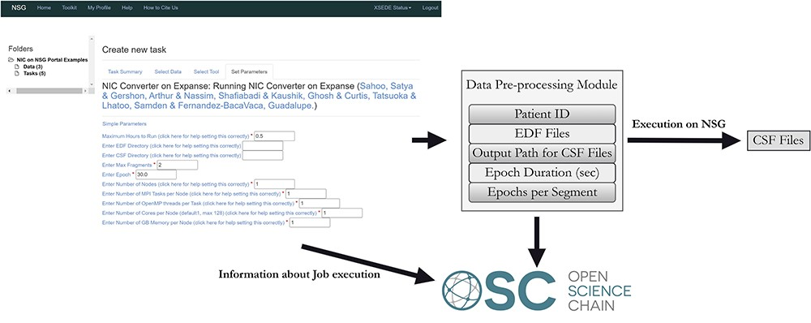
Figure 2. NIC module execution on NSG and passing on the metadata to OSC.
Notes:
Figure 2. NIC module execution on NSG and passing on the metadata to OSC.
Unless provided in the caption above, the following copyright applies to the content of this slide: © The Author(s) 2024. Published by Oxford University Press.This is an Open Access article distributed under the terms of the Creative Commons Attribution License (https://creativecommons.org/licenses/by/4.0/), which permits unrestricted reuse, distribution, and reproduction in any medium, provided the original work is properly cited.

Slide 3
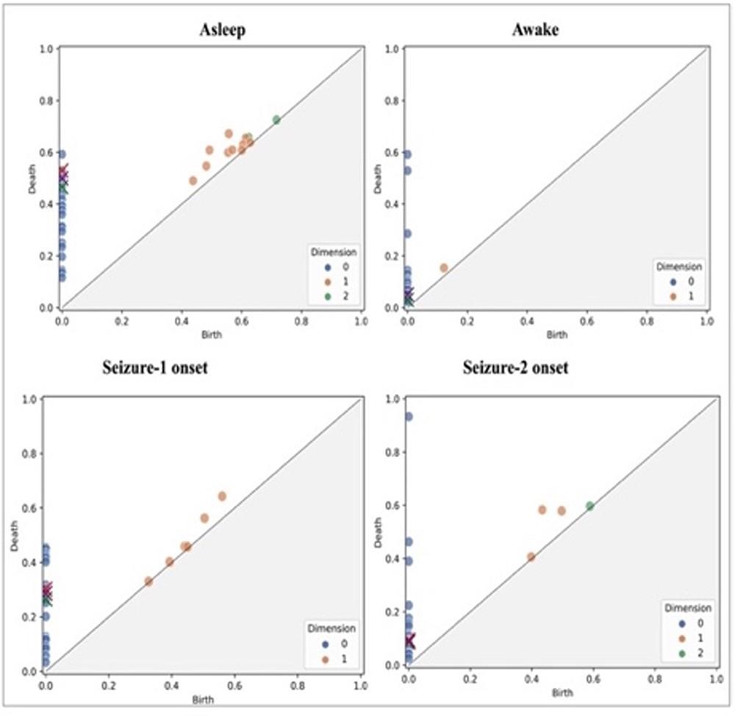
Figure 3. Scatter plots of homology classes for a patient (persistence diagrams) corresponding to asleep, awake, ...
Notes:
Figure 3. Scatter plots of homology classes for a patient (persistence diagrams) corresponding to asleep, awake, seizure one onset and seizure two onset states.
Unless provided in the caption above, the following copyright applies to the content of this slide: © The Author(s) 2024. Published by Oxford University Press.This is an Open Access article distributed under the terms of the Creative Commons Attribution License (https://creativecommons.org/licenses/by/4.0/), which permits unrestricted reuse, distribution, and reproduction in any medium, provided the original work is properly cited.

Slide 4
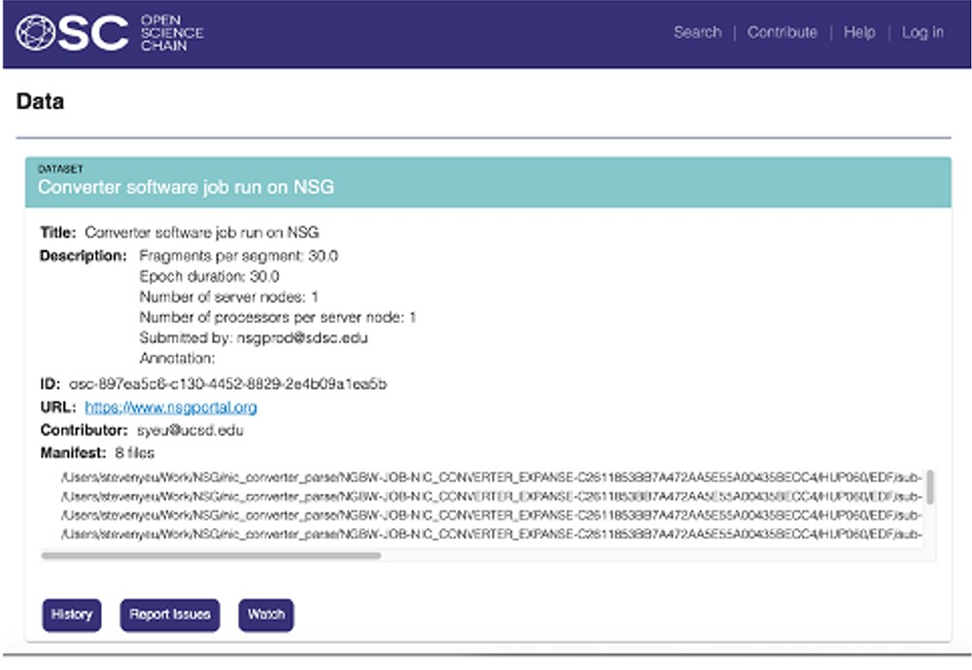
Figure 4. Data and metadata stored in the blockchain.
Notes:
Figure 4. Data and metadata stored in the blockchain.
Unless provided in the caption above, the following copyright applies to the content of this slide: © The Author(s) 2024. Published by Oxford University Press.This is an Open Access article distributed under the terms of the Creative Commons Attribution License (https://creativecommons.org/licenses/by/4.0/), which permits unrestricted reuse, distribution, and reproduction in any medium, provided the original work is properly cited.

