Slide 1
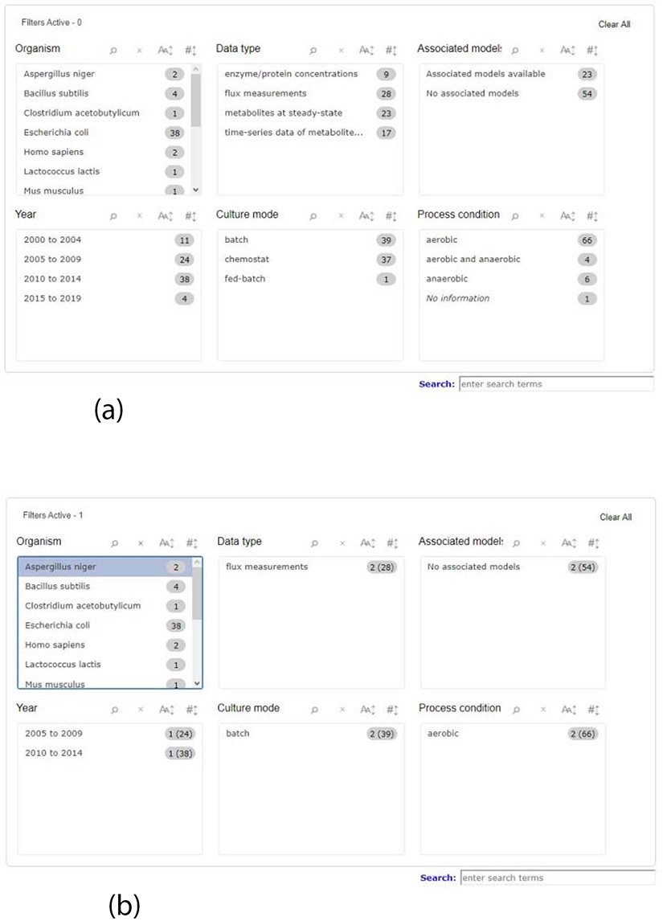
Figure 1. Screenshot of the new filter panel and its interactions. Ahead of each item, there is a number that ...
Notes:
Figure 1. Screenshot of the new filter panel and its interactions. Ahead of each item, there is a number that represents its amount present in the database. (a) A filter panel for the repository table. (b) An example of the new filter panel after the selection of an item; the panel refreshes according to the selected filter and the remaining available options. The numbers are updated: the value outside the parentheses is the remaining amount of data entries that exist according to the filters selected, while the value inside the parentheses is the total number present in the database.
Unless provided in the caption above, the following copyright applies to the content of this slide: © The Author(s) 2020. Published by Oxford University Press.This is an Open Access article distributed under the terms of the Creative Commons Attribution License (http://creativecommons.org/licenses/by/4.0/), which permits unrestricted reuse, distribution, and reproduction in any medium, provided the original work is properly cited.

