Slide 1
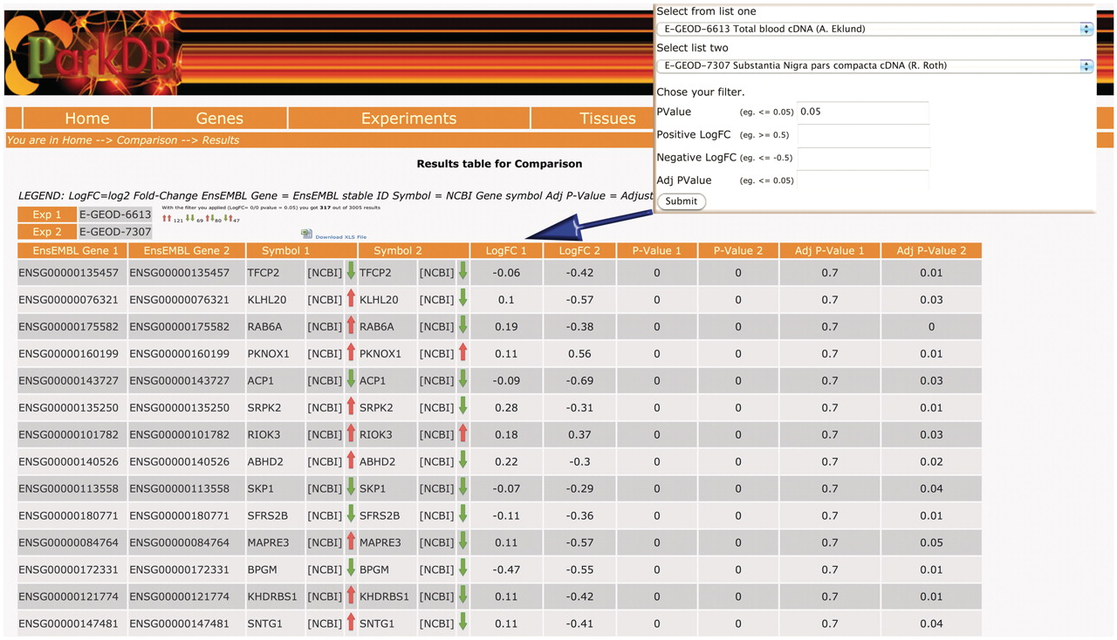
Figure 4. Comparison query. The table shows the common genes obtained comparing substantia nigra from PD patients and a ...
Notes:
Figure 4. Comparison query. The table shows the common genes obtained comparing substantia nigra from PD patients and a transgenic mice that over-expresses HSP70/SNCA. The resulting view also highlights whether the genes were found to be up-regulated/down-regulated or anti-correlated, in two different comparisons.
Unless provided in the caption above, the following copyright applies to the content of this slide: © The Author(s) 2011. Published by Oxford University Press.This is Open Access article distributed under the terms of the Creative Commons Attribution Non-Commercial License (http://creativecommons.org/licenses/by-nc/2.5), which permits unrestricted non-commercial use, distribution, and reproduction in any medium, provided the original work is properly cited.

