Slide 1
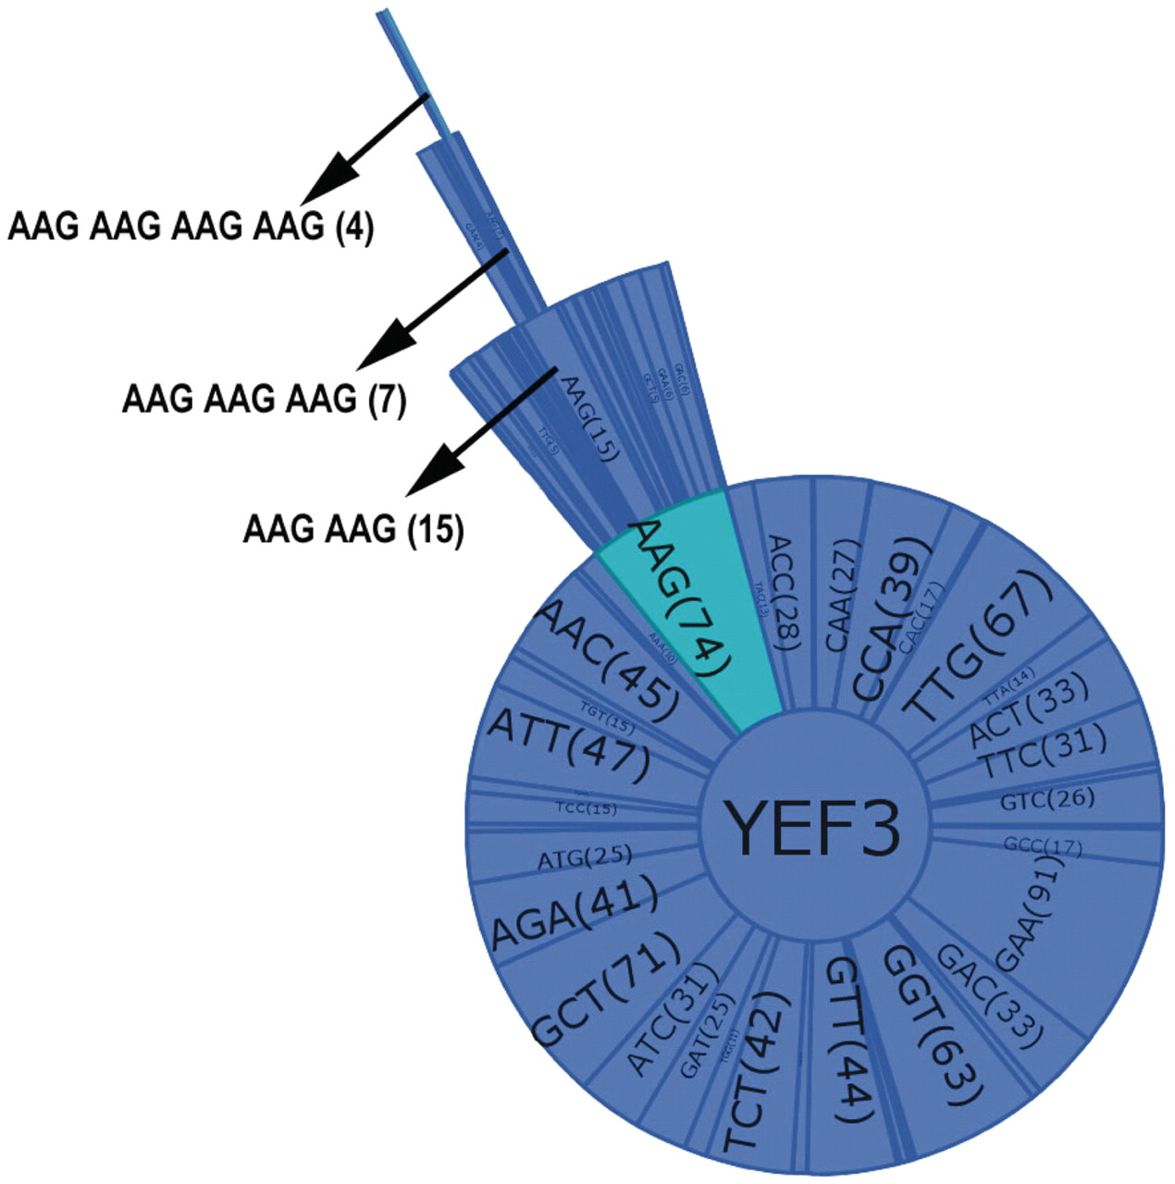
Figure 3 Combination graph of YEF3. Each sector of the graph represents a codon with the name and the number of each ...
Notes:
Figure 3 Combination graph of YEF3. Each sector of the graph represents a codon with the name and the number of each codon in parenthesis. The selected codon combination (as shown by arrow in the Figure) also details the number of occurrences in each gene.
Unless provided in the caption above, the following copyright applies to the content of this slide: © The Author(s) 2012. Published by Oxford University Press.This is an Open Access article distributed under the terms of the Creative Commons Attribution Non-Commercial License (http://creativecommons.org/licenses/by-nc/3.0), which permits unrestricted non-commercial use, distribution, and reproduction in any medium, provided the original work is properly cited.

