Slide 1
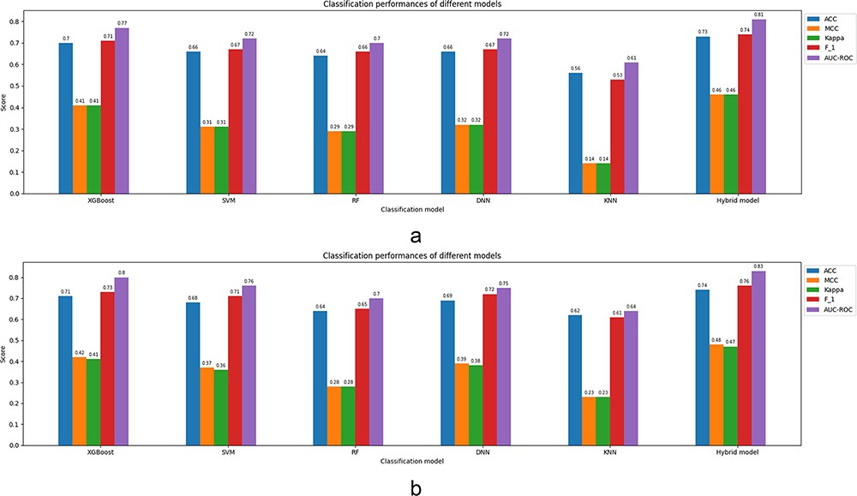
Figure 4. Classification parameters corresponding to the prediction models fed by the full feature set ...
Notes:
Figure 4. Classification parameters corresponding to the prediction models fed by the full feature set (EAAC + EGAAC + BLOSUM62 + PSSM) of window size 35 for both cases: 5-fold CV and independent test. (a) Results corresponding to a 5-fold CV. (b) Results corresponding to an independent test.
Unless provided in the caption above, the following copyright applies to the content of this slide: © The Author(s) 2024. Published by Oxford University Press.This is an Open Access article distributed under the terms of the Creative Commons Attribution License (https://creativecommons.org/licenses/by/4.0/), which permits unrestricted reuse, distribution, and reproduction in any medium, provided the original work is properly cited.

