Slide 1
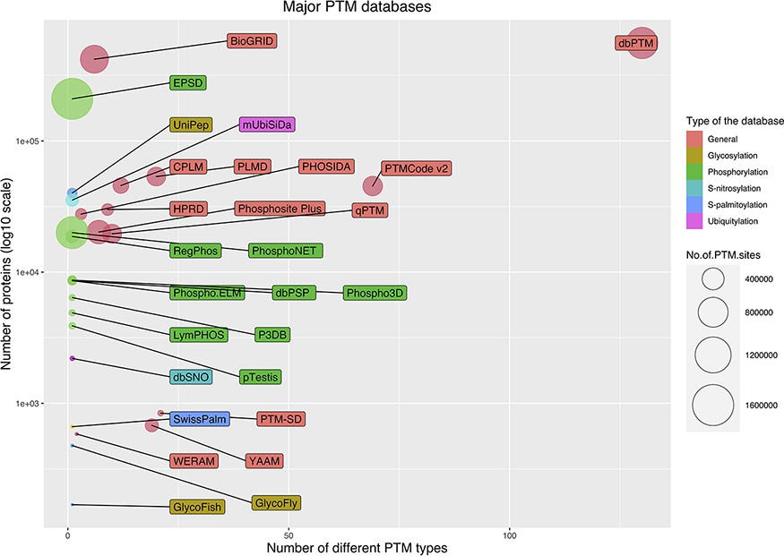
Figure 5. Bubble chart for PTM databases. The chart was drawn based on three parameters for the databases: the number ...
Notes:
Figure 5. Bubble chart for PTM databases. The chart was drawn based on three parameters for the databases: the number of stored modified proteins, the number of modified sites and the number of covered PTM types.
Unless provided in the caption above, the following copyright applies to the content of this slide: © The Author(s) 2021. Published by Oxford University Press. All rights reserved. For permissions, please e-mail: journals.permissions@oup.comThis article is published and distributed under the terms of the Oxford University Press, Standard Journals Publication Model (https://academic.oup.com/journals/pages/open_access/funder_policies/chorus/standard_publication_model)

