Slide 1
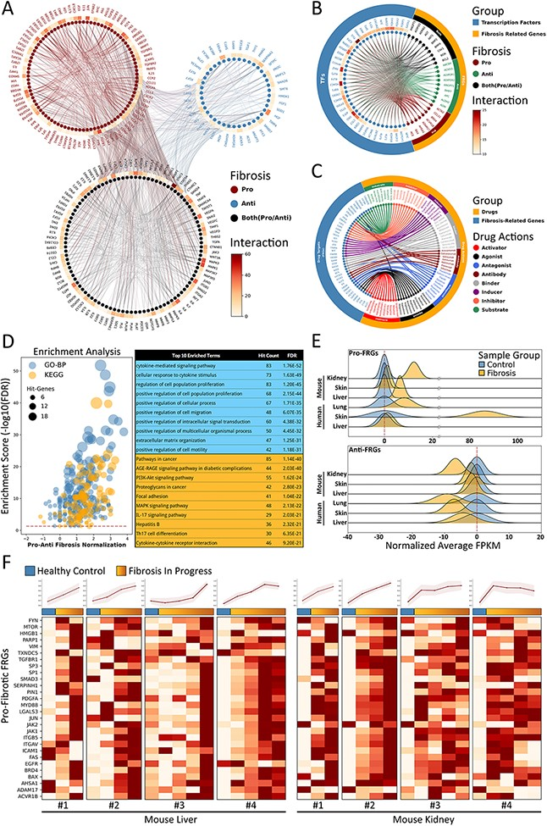
Figure 4. Fibrosis-Related Genes in FibROAD. (A) Circos plot for protein-protein interactions of all 232 FRGs as ...
Notes:
Figure 4. Fibrosis-Related Genes in FibROAD. (A) Circos plot for protein-protein interactions of all 232 FRGs as obtained from the String database. FRGs are divided into three groups (pro/anti/both shown in different colors) according to evidence contained within the literature. Interaction counts (edges number) for each FRG are presented with a circular heatmap around each circle. (B) Circos plot for several example transcription factors-FRGs regulations according to hTFtarget and RNAinter databases. Transcription factors are shown in orange whereas FRGs are divided into the three groups as described above and shown in steel blue. Regulation counts (edges number) for each transcription factor are shown with a surrounding circular heatmap. (C) Circos plot for several examples of drug targets according to the DrugBank database. Drugs are shown in orange whereas gene targets (FRGs) in steel blue. The eight different drug actions are presented using different colors. (D) Gene ontology (biological processes, steel blue) and KEGG (orange) enrichment analysis for FRGs (left panel). The pro/anti-fibrosis normalization (x-axis) was performed by calculating the z-score for pro- and anti-fibrosis FRGs within each term. The enrichment score (y-axis) was calculated with FDR from the hyper-geometry test. Red dashed line refers to the FDR threshold (0.05). The top 10 enriched terms of GO-BP (steel blue) and KEGG (orange) are shown in the right panel. (E) The average expressions (FPKM) of pro- (upper panel) and anti- (lower panel) FRGs in several datasets, with expressions of fibrotic groups (orange) normalized to that of control groups (steel blue). (F) Expressions (FPKM) of detected pro-fibrotic FRGs in datasets designed for fibrosis progression research. Results from healthy control groups are indicated in steel blue whereas fibrotic groups are displayed in orange gradients. Results of 4 independent datasets for mouse liver (left panel) and mouse kidney (right panel) are each illustrated in heatmaps, with normalized average expressions depicted in line plots at the top.
Unless provided in the caption above, the following copyright applies to the content of this slide: © The Author(s) 2022. Published by Oxford University Press.This is an Open Access article distributed under the terms of the Creative Commons Attribution License (https://creativecommons.org/licenses/by/4.0/), which permits unrestricted reuse, distribution, and reproduction in any medium, provided the original work is properly cited.

