Slide 1
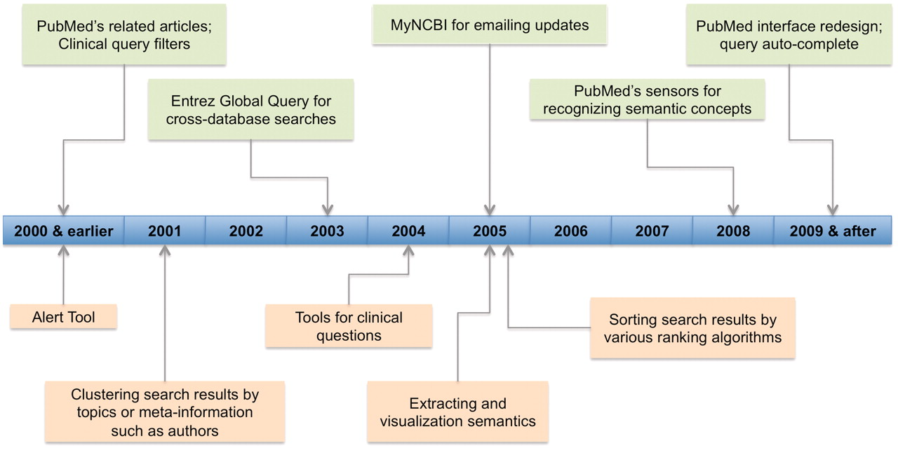
Figure 4. Technology development timeline for PubMed (in light green color) and other biomedical literature search ...
Notes:
Figure 4. Technology development timeline for PubMed (in light green color) and other biomedical literature search tools (in light orange color). For PubMed, it shows the staring year when various recent changes (limited to those mentioned in ‘Changes to PubMed and looking into the future’ section) were introduced. For other tools, we show the time period in which tools of various features were first appeared.
Unless provided in the caption above, the following copyright applies to the content of this slide: © The Author(s) 2011. Published by Oxford University Press.This is Open Access article distributed under the terms of the Creative Commons Attribution Non-Commercial License (http://creativecommons.org/licenses/by-nc/2.5), which permits unrestricted non-commercial use, distribution, and reproduction in any medium, provided the original work is properly cited.

