Slide 1
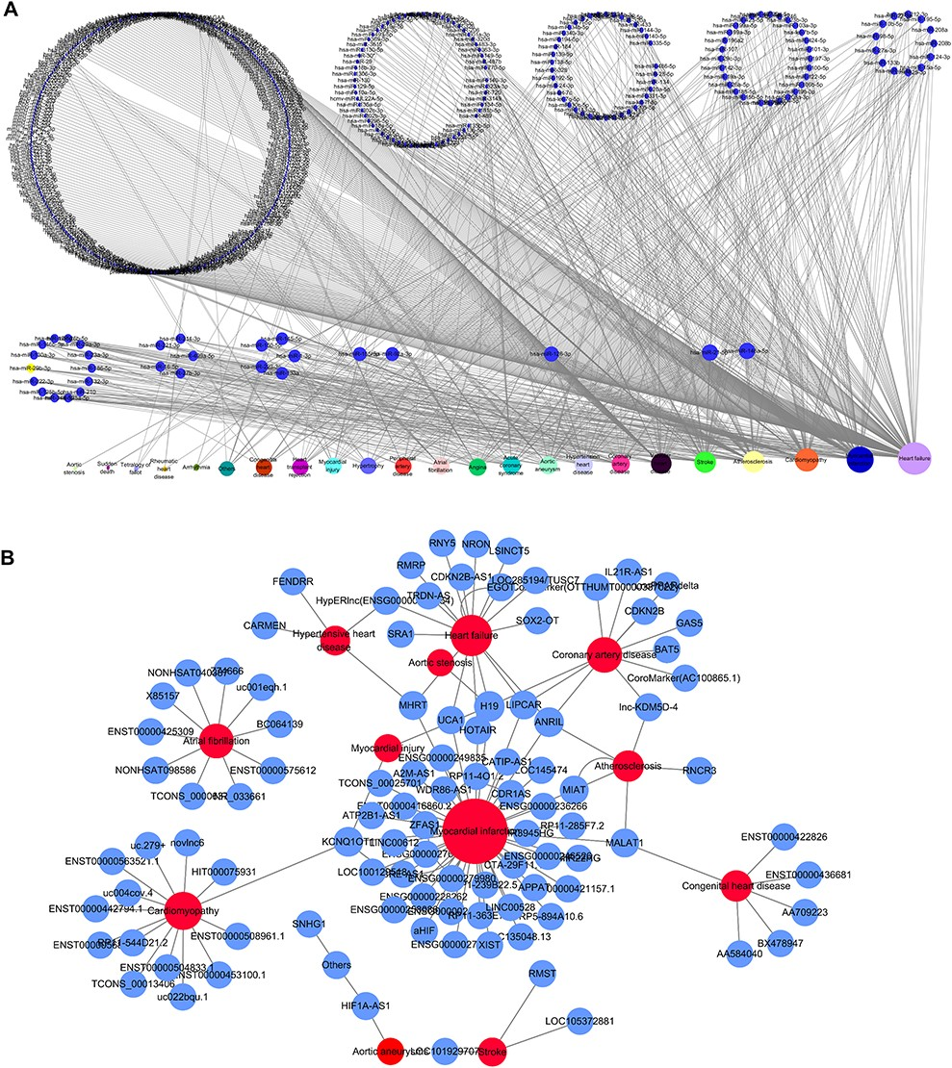
Figure 4 Network distribution of ncRNAs related to CVDs. (A) Overview of the miRNA–CVD network; the bottom row shows ...
Notes:
Figure 4 Network distribution of ncRNAs related to CVDs. (A) Overview of the miRNA–CVD network; the bottom row shows the diseases, and the size of the circles is proportional to the number of associated miRNAs. (B) Overview of the lncRNA–CVD network; red circles represent diseases, blue circles are lncRNAs and the size of the circles is proportional to the number of associated lncRNAs.
Unless provided in the caption above, the following copyright applies to the content of this slide: © The Author(s) 2020. Published by Oxford University Press.This is an Open Access article distributed under the terms of the Creative Commons Attribution License (http://creativecommons.org/licenses/by/4.0/), which permits unrestricted reuse, distribution, and reproduction in any medium, provided the original work is properly cited.

