Slide 1
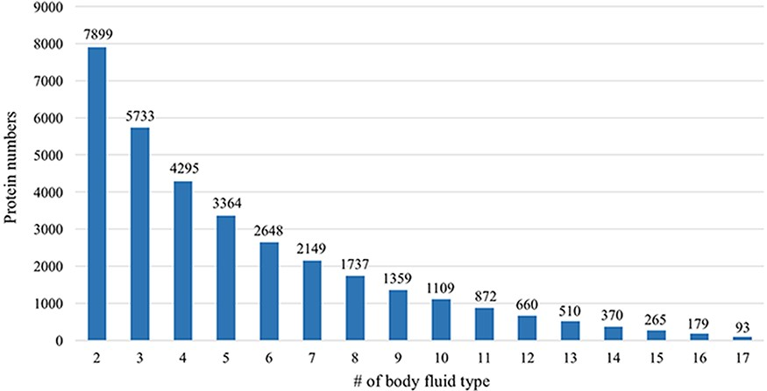
Figure 6. Comparative analysis across different body fluids. Seven thousand eight hundred and ninety-nine (7899) ...
Notes:
Figure 6. Comparative analysis across different body fluids. Seven thousand eight hundred and ninety-nine (7899) proteins are presented in at least two body fluids and 5733 proteins existed in at least three body fluids. Only 93 proteins exist in all 17 body fluids.
Unless provided in the caption above, the following copyright applies to the content of this slide: © The Author(s) 2021. Published by Oxford University Press.This is an Open Access article distributed under the terms of the Creative Commons Attribution License (https://creativecommons.org/licenses/by/4.0/), which permits unrestricted reuse, distribution, and reproduction in any medium, provided the original work is properly cited.

