Slide 1
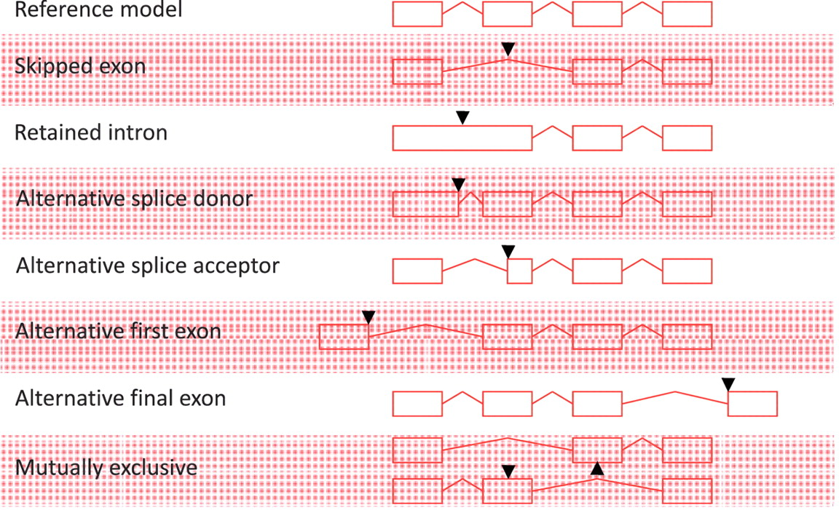
Figure 1 Alternative splicing events. All possible individual alternative splicing events are shown. Black arrowheads ...
Notes:
Figure 1 Alternative splicing events. All possible individual alternative splicing events are shown. Black arrowheads indicate position of difference with a conceptual reference model (top).
Unless provided in the caption above, the following copyright applies to the content of this slide: © The Author(s) 2012. Published by Oxford University Press.This is an Open Access article distributed under the terms of the Creative Commons Attribution Non-Commercial License (http://creativecommons.org/licenses/by-nc/3.0), which permits unrestricted non-commercial use, distribution, and reproduction in any medium, provided the original work is properly cited.

Slide 2
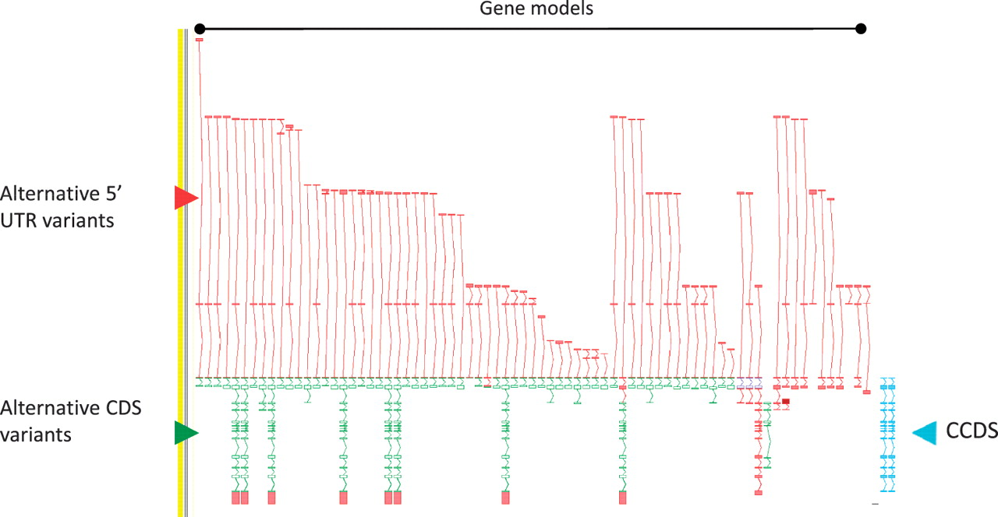
Figure 2 Zmap screenshot of the GPCR56 locus encoding human G protein-coupled receptor 56. This locus has 76 ...
Notes:
Figure 2 Zmap screenshot of the GPCR56 locus encoding human G protein-coupled receptor 56. This locus has 76 non-redundant AS transcripts, the majority of which are EST based, 3′ truncated and show variation in the 5′ UTR. Red arrowhead indicates 5′ UTR, green arrowhead indicates CDS and blue arrowhead indicate the two CCDS variants annotated at this locus.
Unless provided in the caption above, the following copyright applies to the content of this slide: © The Author(s) 2012. Published by Oxford University Press.This is an Open Access article distributed under the terms of the Creative Commons Attribution Non-Commercial License (http://creativecommons.org/licenses/by-nc/3.0), which permits unrestricted non-commercial use, distribution, and reproduction in any medium, provided the original work is properly cited.

Slide 3
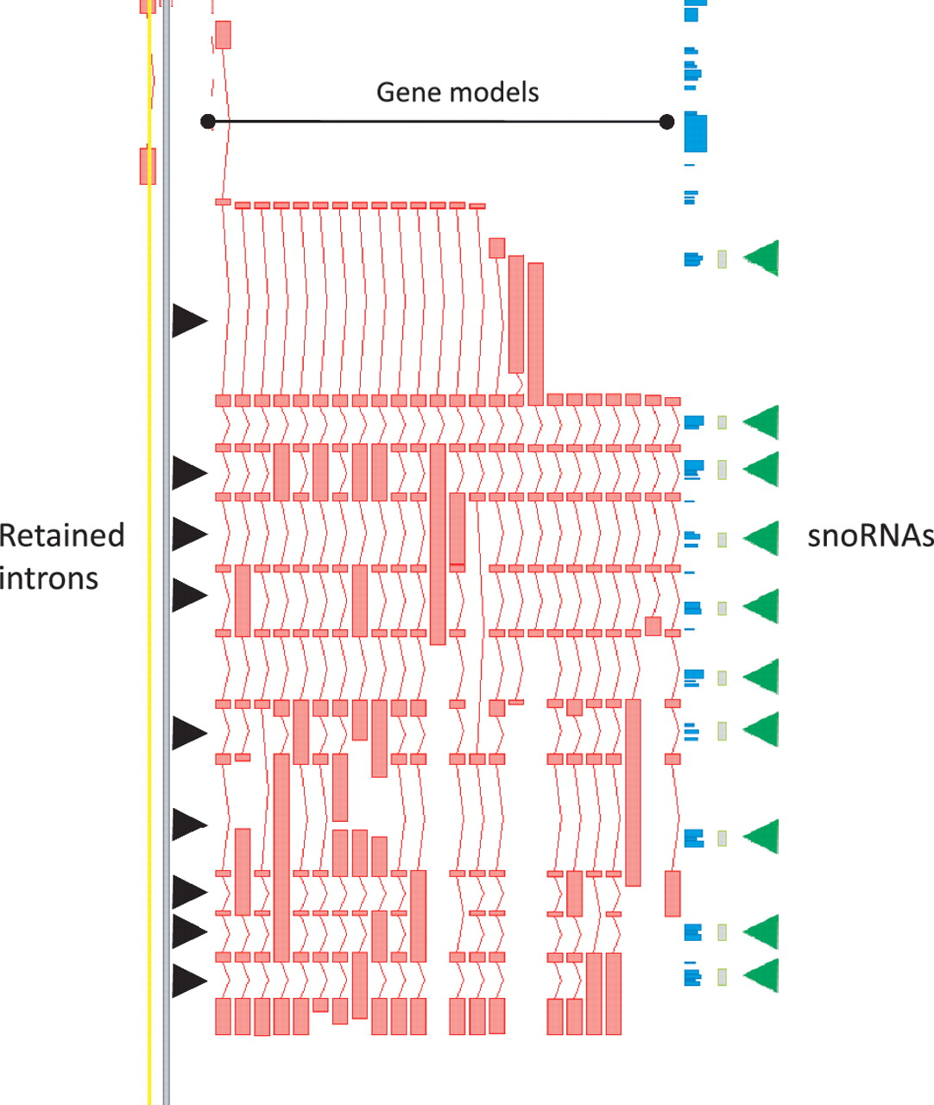
Figure 3 Zmap screenshot of the GAS5 locus encoding growth arrest-specific 5 (non-protein coding). This locus has 29 ...
Notes:
Figure 3 Zmap screenshot of the GAS5 locus encoding growth arrest-specific 5 (non-protein coding). This locus has 29 non-redundant AS transcripts, including many containing retained introns. Black arrowheads indicate those introns retained in at least one transcript. Green arrowheads indicate intronic snoRNAs.
Unless provided in the caption above, the following copyright applies to the content of this slide: © The Author(s) 2012. Published by Oxford University Press.This is an Open Access article distributed under the terms of the Creative Commons Attribution Non-Commercial License (http://creativecommons.org/licenses/by-nc/3.0), which permits unrestricted non-commercial use, distribution, and reproduction in any medium, provided the original work is properly cited.

Slide 4
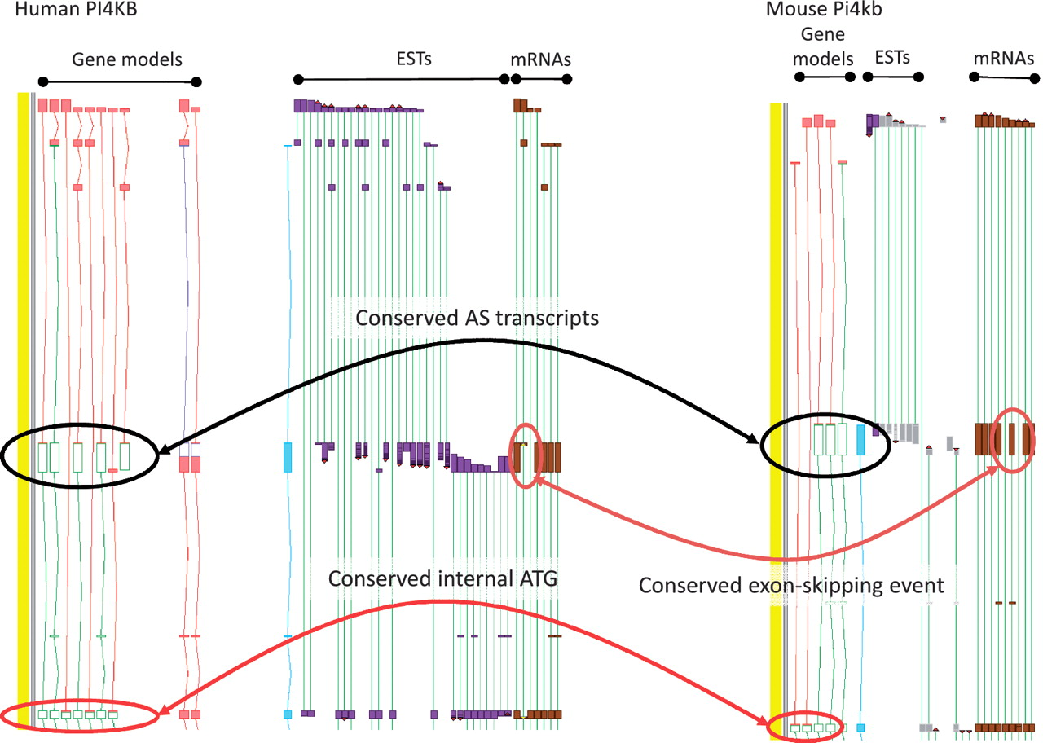
Figure 4 Zmap screenshot of the PI4KB/Pi4kb genes encoding phosphatidylinositol 4-kinase, catalytic, beta in human ...
Notes:
Figure 4 Zmap screenshot of the PI4KB/Pi4kb genes encoding phosphatidylinositol 4-kinase, catalytic, beta in human (left) and mouse (right) respectively. Black ovals highlight exon-skipping event observed in both species, orange ovals highlight the species-specific mRNA evidence supporting the annotation of the exon-skip event and red ovals highlight the conserved internal ATG likely to be utilised in the event of the exon-skip.
Unless provided in the caption above, the following copyright applies to the content of this slide: © The Author(s) 2012. Published by Oxford University Press.This is an Open Access article distributed under the terms of the Creative Commons Attribution Non-Commercial License (http://creativecommons.org/licenses/by-nc/3.0), which permits unrestricted non-commercial use, distribution, and reproduction in any medium, provided the original work is properly cited.

Slide 5
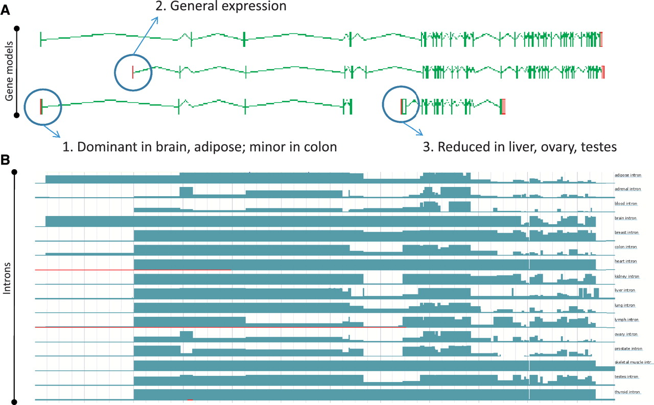
Figure 5 Zmap screenshot of four representative full-length transcripts at the human PDE4DIP locus encoding ...
Notes:
Figure 5 Zmap screenshot of four representative full-length transcripts at the human PDE4DIP locus encoding phosphodiesterase 4D interacting protein (A) and screenshot of the Ensembl display of introns built using the Illumia Bodymap2 RNA-Seq dataset (B). The three main transcription start sites (TSS) associated with the locus are circled and the primary tissue types in which the TSSs are up or downregulated are indicated.
Unless provided in the caption above, the following copyright applies to the content of this slide: © The Author(s) 2012. Published by Oxford University Press.This is an Open Access article distributed under the terms of the Creative Commons Attribution Non-Commercial License (http://creativecommons.org/licenses/by-nc/3.0), which permits unrestricted non-commercial use, distribution, and reproduction in any medium, provided the original work is properly cited.

Slide 6
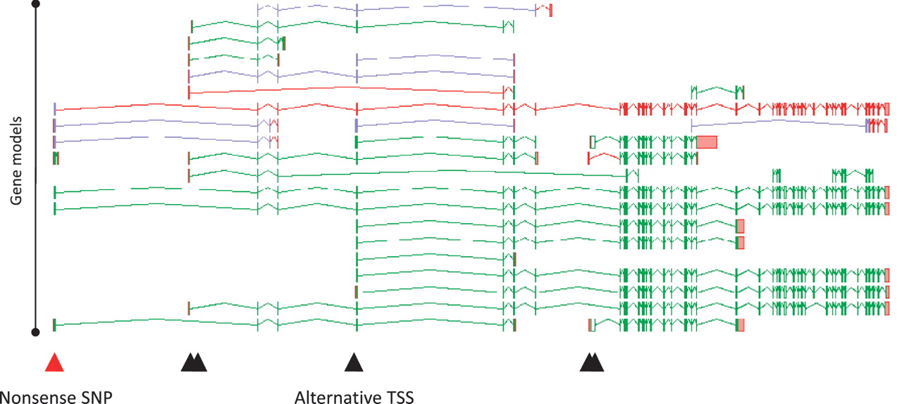
Figure 6 Zmap screenshot of all transcripts at the human PDE4DIP locus encoding phosphodiesterase 4D interacting ...
Notes:
Figure 6 Zmap screenshot of all transcripts at the human PDE4DIP locus encoding phosphodiesterase 4D interacting protein. The red arrowhead indicates the position of a disabling nonsense SNP, black arrowheads indicate the positions of alternative TSSs.
Unless provided in the caption above, the following copyright applies to the content of this slide: © The Author(s) 2012. Published by Oxford University Press.This is an Open Access article distributed under the terms of the Creative Commons Attribution Non-Commercial License (http://creativecommons.org/licenses/by-nc/3.0), which permits unrestricted non-commercial use, distribution, and reproduction in any medium, provided the original work is properly cited.

Slide 7
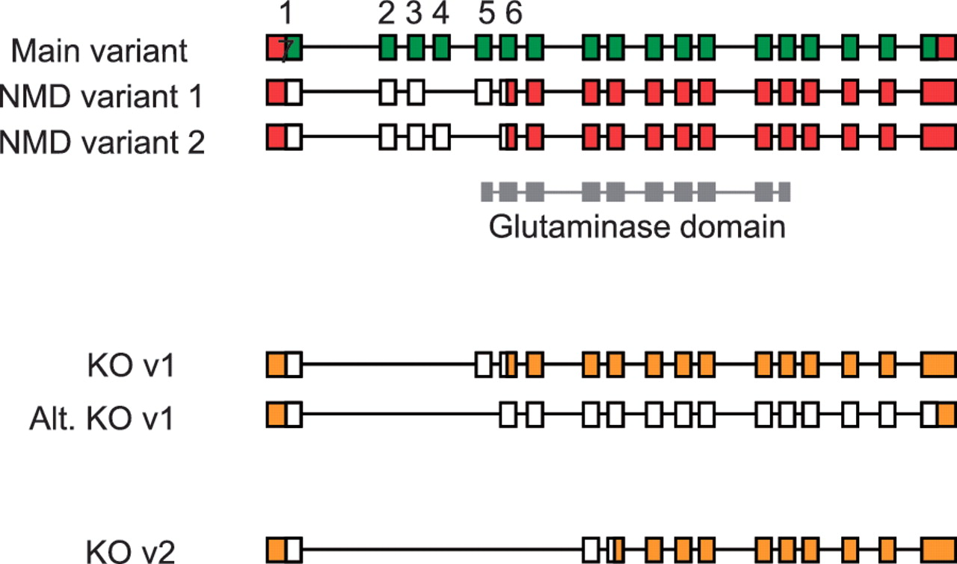
Figure 7 Validation of vector designs for Gls2 gene. The main exon structure of Gls2 (main variant) is displayed ...
Notes:
Figure 7 Validation of vector designs for Gls2 gene. The main exon structure of Gls2 (main variant) is displayed alongside NMD variants 1 and 2 based on mRNAs BC02566.1 and AK039618.1, respectively. Hypothetical knockout (KO) transcripts based on annotated structures are shown. Knockout transcript, KO v1, is derived from the main variant and NMD variant 1, where as the alternative version (Alt. KO v1) is derived from NMD variant 2. Exons 1 to 7 are numbered with coding regions displayed in green (main variant) or white (NMD and KO variants) and untranslated regions (UTR) shown in red or orange. The Gls2 glutaminase domain is shown in grey, overlapping exon structure.
Unless provided in the caption above, the following copyright applies to the content of this slide: © The Author(s) 2012. Published by Oxford University Press.This is an Open Access article distributed under the terms of the Creative Commons Attribution Non-Commercial License (http://creativecommons.org/licenses/by-nc/3.0), which permits unrestricted non-commercial use, distribution, and reproduction in any medium, provided the original work is properly cited.

